Slide 1
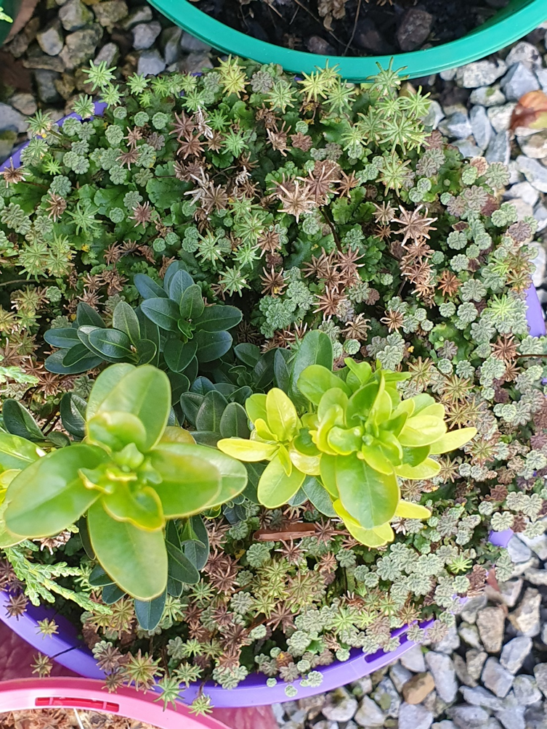
A Weed Control Information Package for Management of Nursery Weeds
Dr Virginia Williamson, University of Melbourne
David Reid, Nursery & Garden Industry Victoria

Slide 2
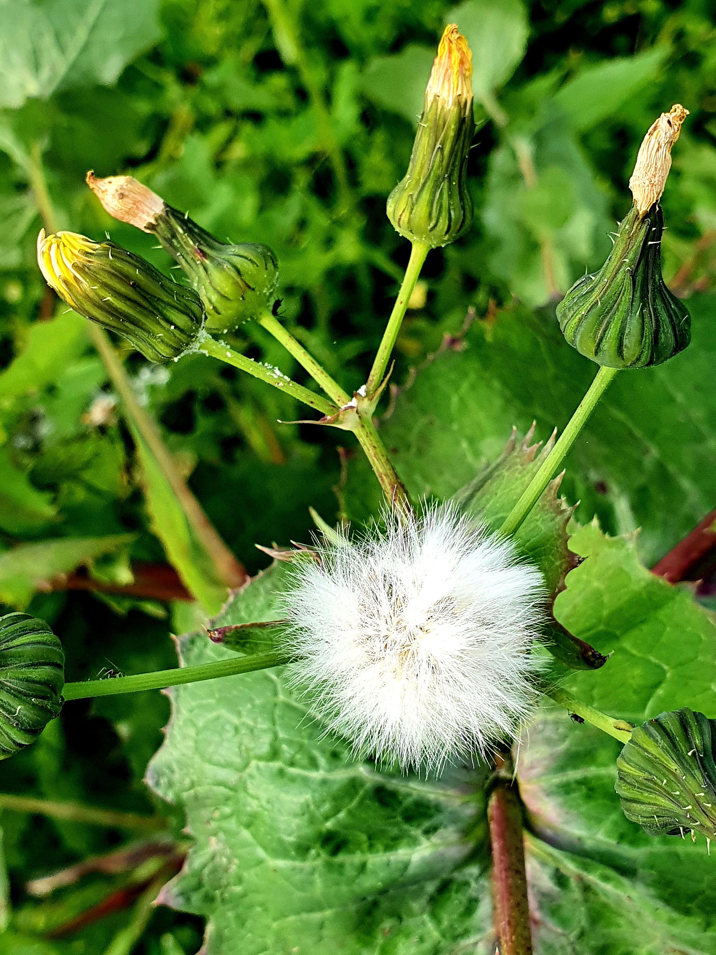
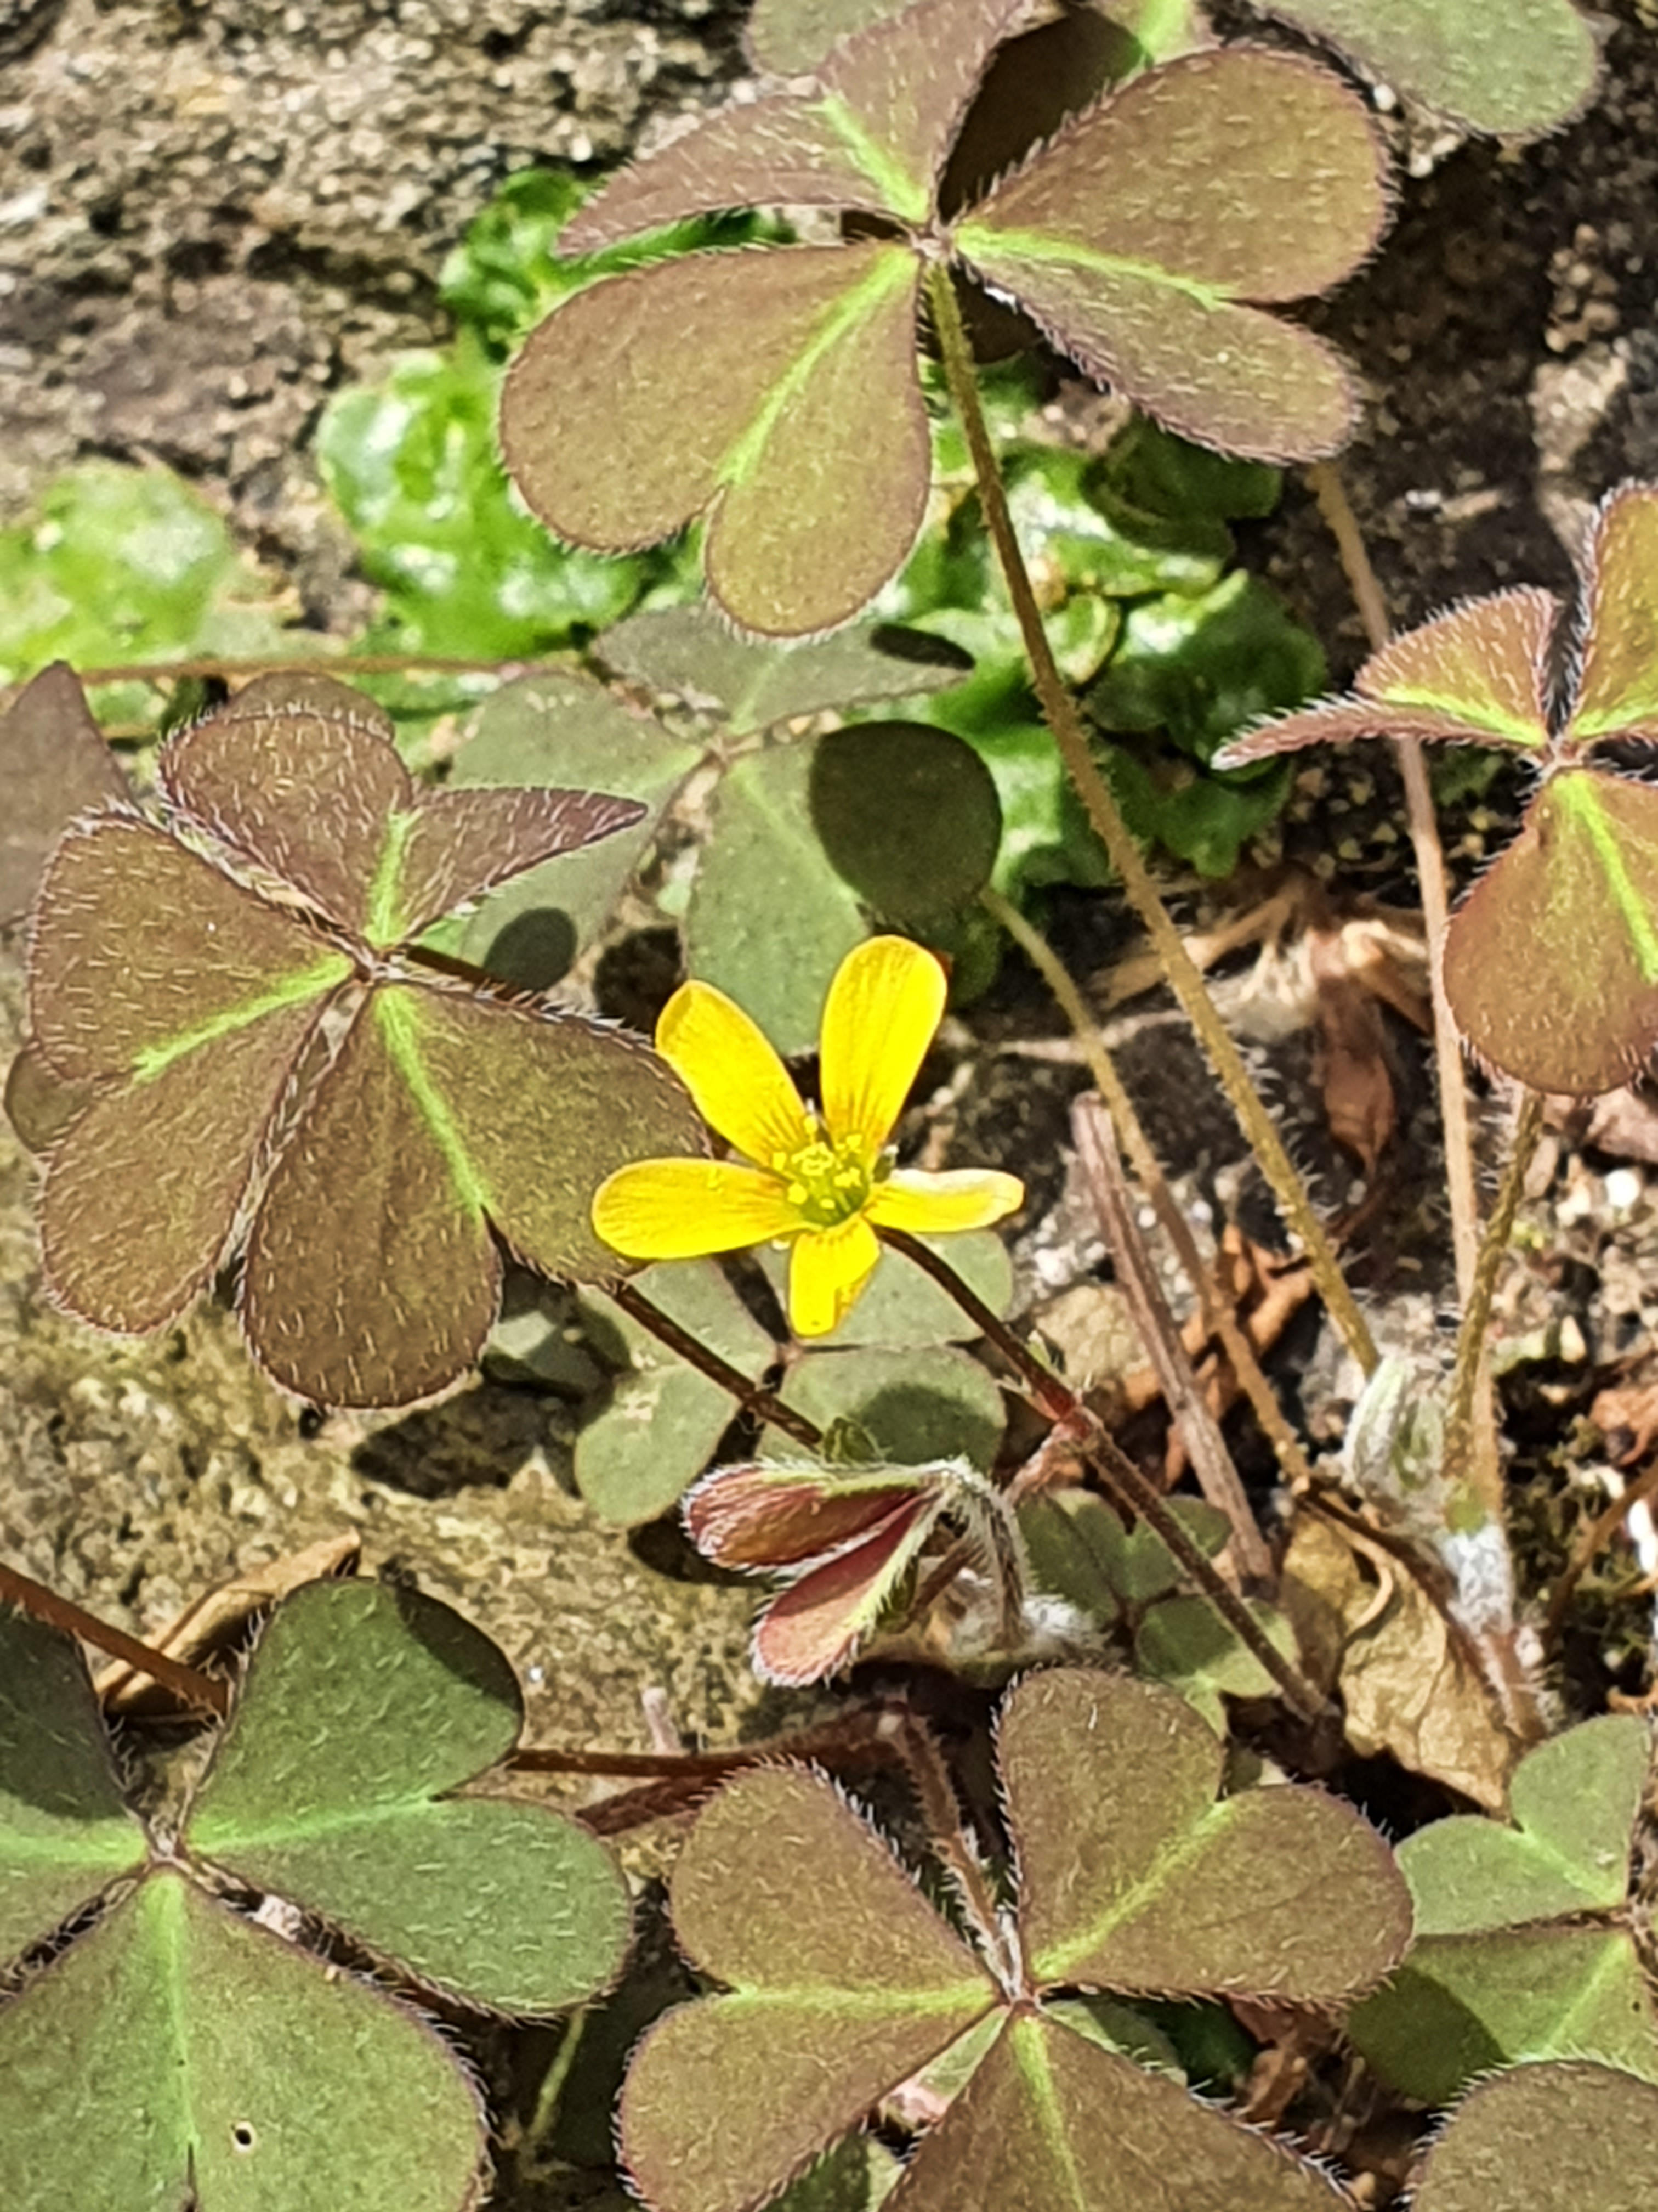
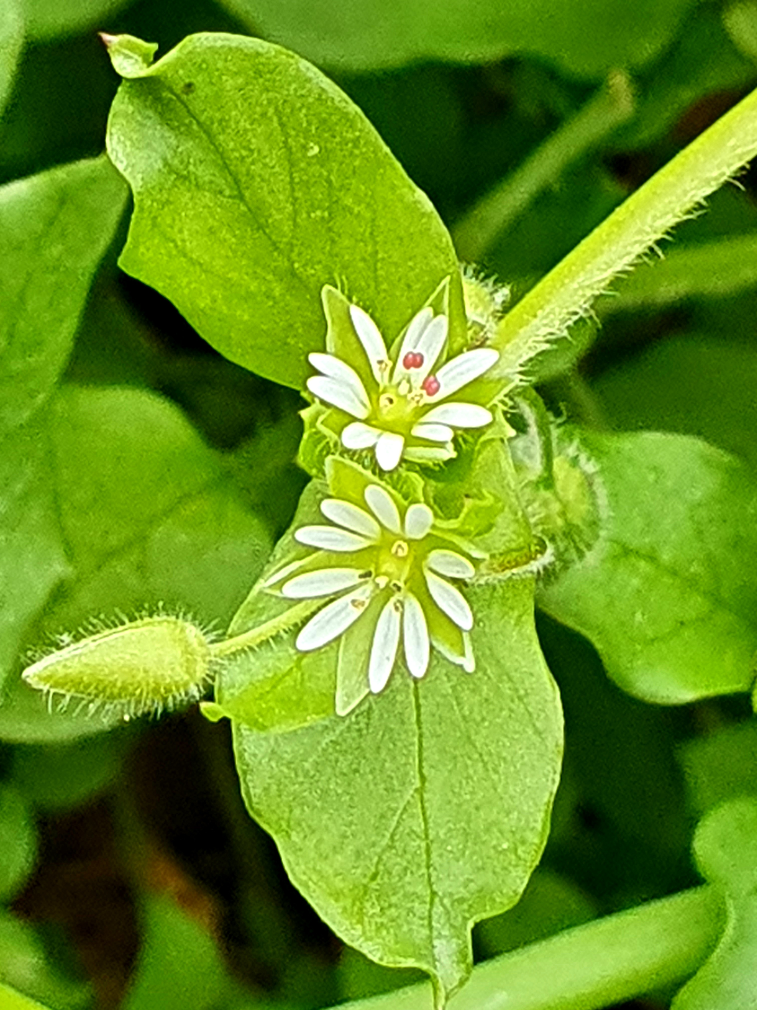
Background and Aims
Following a 2015 NGIV survey of growers, their 21 most problematic weeds were determined
Weeds significantly reduce nursery profits and productivity
Current weed control information world-wide is fragmented and not always suitable for Australia
There was a need to produce a comprehensive weed management guide so relevant information was readily accessible for Victorian growers
Herbicide use is then more appropriate, reducing both costs and the likelihood of further herbicide resistance occurring

Slide 3
Methods
A desktop study of available weed control literature world-wide for the 21 weeds was done
From this, comprehensive and suitable weed control measures for Victorian nurseries were determined
After consultation with 3 key nurseries and a statistician, a Liverwort weed control experiment was undertaken at those 3 nurseries
Nursery staff set up and monitored experiment with direction from researchers
Experiment ran for 12 weeks

Slide 4
Results
Liverwort was effectively controlled with Slasher® (nonanoic acid) and also baking soda (see graphs)
A guide for control of the 21 problematic nursery weeds was produced covering:
description/habit; reproduction; dispersal; life cycle; cultural control; chemical control
Two articles on the project were written and published in the Victorian nursery industry’s magazine, Groundswell in 2019 and 2020
Presentations at nursery grower meetings were planned but postponed because of Covid-19. We hope to do these in 2021.
Professional layout of our guide is occurring
The guide will be available to the nursery industry shortly

Slide 5
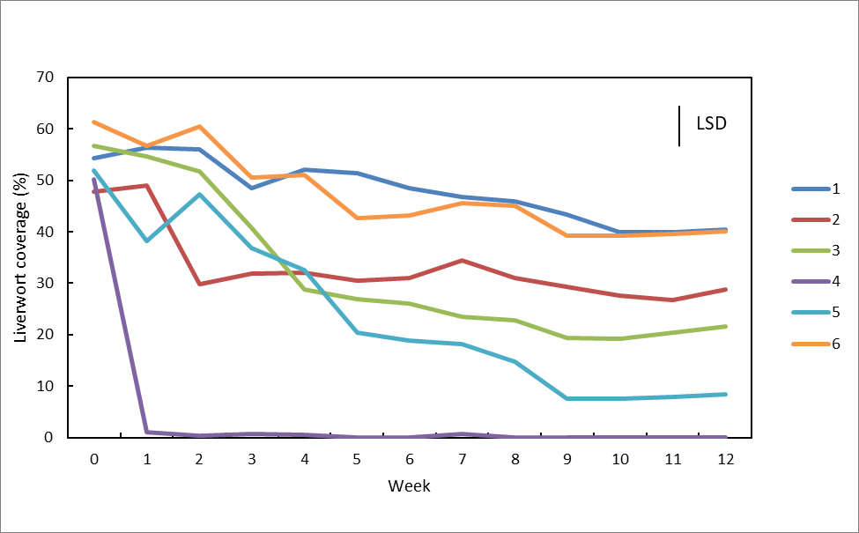
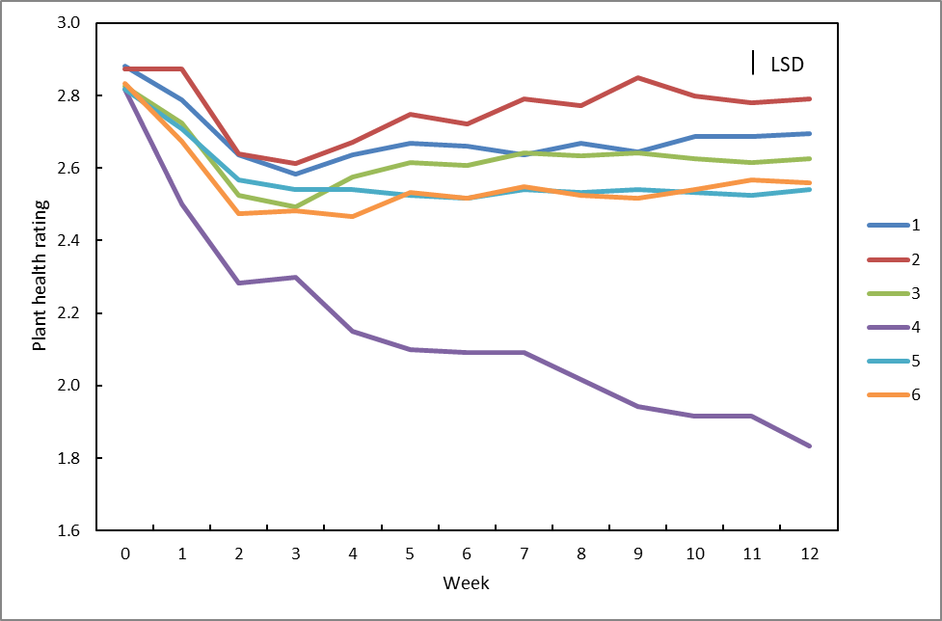
Results (cont’d)
Slasher® (nonanoic acid) and baking soda provided effective Liverwort control
Figure 1. The percentage cover of Liverwort in our experiment over 12 weeks in all crops. T1 = control; T2 = coir discs; T3 = Regen Shield®; T4 = Slasher®; T5 = baking soda; T6 = Rout®. There were 10 replicates per treatment. Where treatment lines are separated by more than the size of the LSD bar, they are significantly different. Treatments 4 (Slasher®) and 5 (baking soda) provided the significantly greatest reduction in Liverwort coverage.
Slasher® (nonanoic acid) damaged wanted plants but if alternated with baking soda and used from when plants are young should not cause damage
Figure 2. The plant health rating (where 0 = dead; 1 = unhealthy; 2 = moderately healthy; 3 = very healthy) of all wanted plants in our Liverwort experiment over 12 weeks. T1 = control; T2 = coir discs; T3 = Regen Shield®; T4 = Slasher®; T5 = baking soda; T6 = Rout®. There were 10 replicates per treatment. Where treatment lines are separated by more than the size of the LSD bar, they are significantly different. Treatment 4 (Slasher®) had the significantly greatest reduction in wanted plant health after week 2.
Further details of our project and results are in Groundswell September 2019 and December 2020, as well as a forthcoming journal article

Slide 6
Acknowledgements
Agriculture Victoria’s Horticulture Innovation Fund
The three participating nurseries & their staff:
Humphris Nursery (Ryan O’Connor),
Mansfield’s Propagation Nursery (Matt Mansfield & Manraj Mann),
Warners Nursery (Bec van Stekelenburgh)
Associate Professor Graham Hepworth
Statistician, The University of Melbourne
Dr Sue Murphy
Honorary, The University of Melbourne

