Slide 1
Evaluation of a portable impact probe for rapid assessments of flesh firmness in peaches and nectarines
A. Scalisi^{1,a}, M.G. O’Connell^{1,2}, A. McGlone³, S. Langdon-Arms³
¹Agriculture Victoria, Tatura, Victoria, Australia;
²Centre for Agricultural Innovation, The University of Melbourne, Australia;
³The New Zealand Institute for Plant and Food Research Limited, Hamilton, New Zealand.

Slide 2
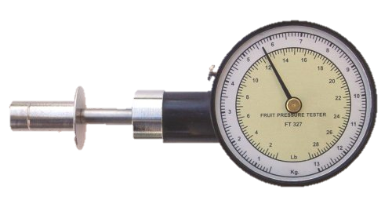
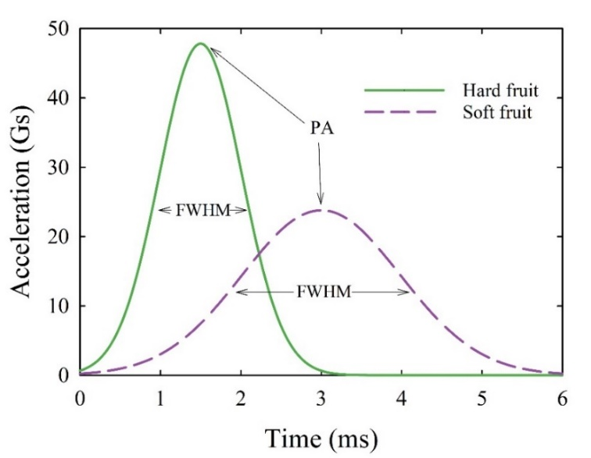
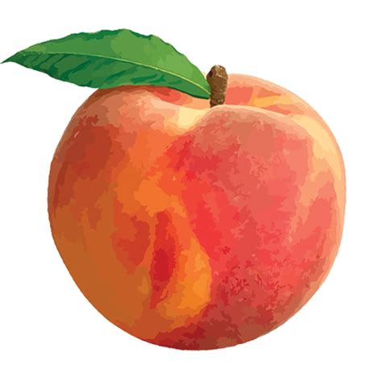
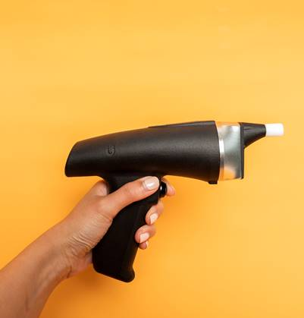
Introduction and methods
Background and aim of the study
Methods
Flesh firmness (FF) is a measure of fruit maturity and quality in stone fruit
Portable non-destructive devices for rapid maturity assessment are sought after by the horticultural industries for in situ and post-harvest use
New handheld instruments provide the opportunity to collect large volumes of data via smartphones and wireless communication (Bluetooth/WiFi)
Aim of the study
Evaluate the suitability of a portable Bluetooth impact probe prototype for rapid flesh firmness assessments in peaches and nectarines.
Experiment conducted in 2019/20 on 200 fruit per cultivar
Peach cultivars: 'August Flame', ‘O’Henry', ‘Redhaven’ and 'September Sun’
Nectarine cultivars: ‘August Bright’, 'Autumn Bright' and 'September Bright’
Reference determination of FF
A penetrometer (FT327, FACCHINI srl, Alfonsine, Italy) equipped with an 8-mm tip.
Portable impact probe
Exerts a known force through a non-penetrating tip.
Bluetooth wireless data communication.
Device outputs:
Peak acceleration (PA)
Full width at half maximum (FWHM)

Slide 3
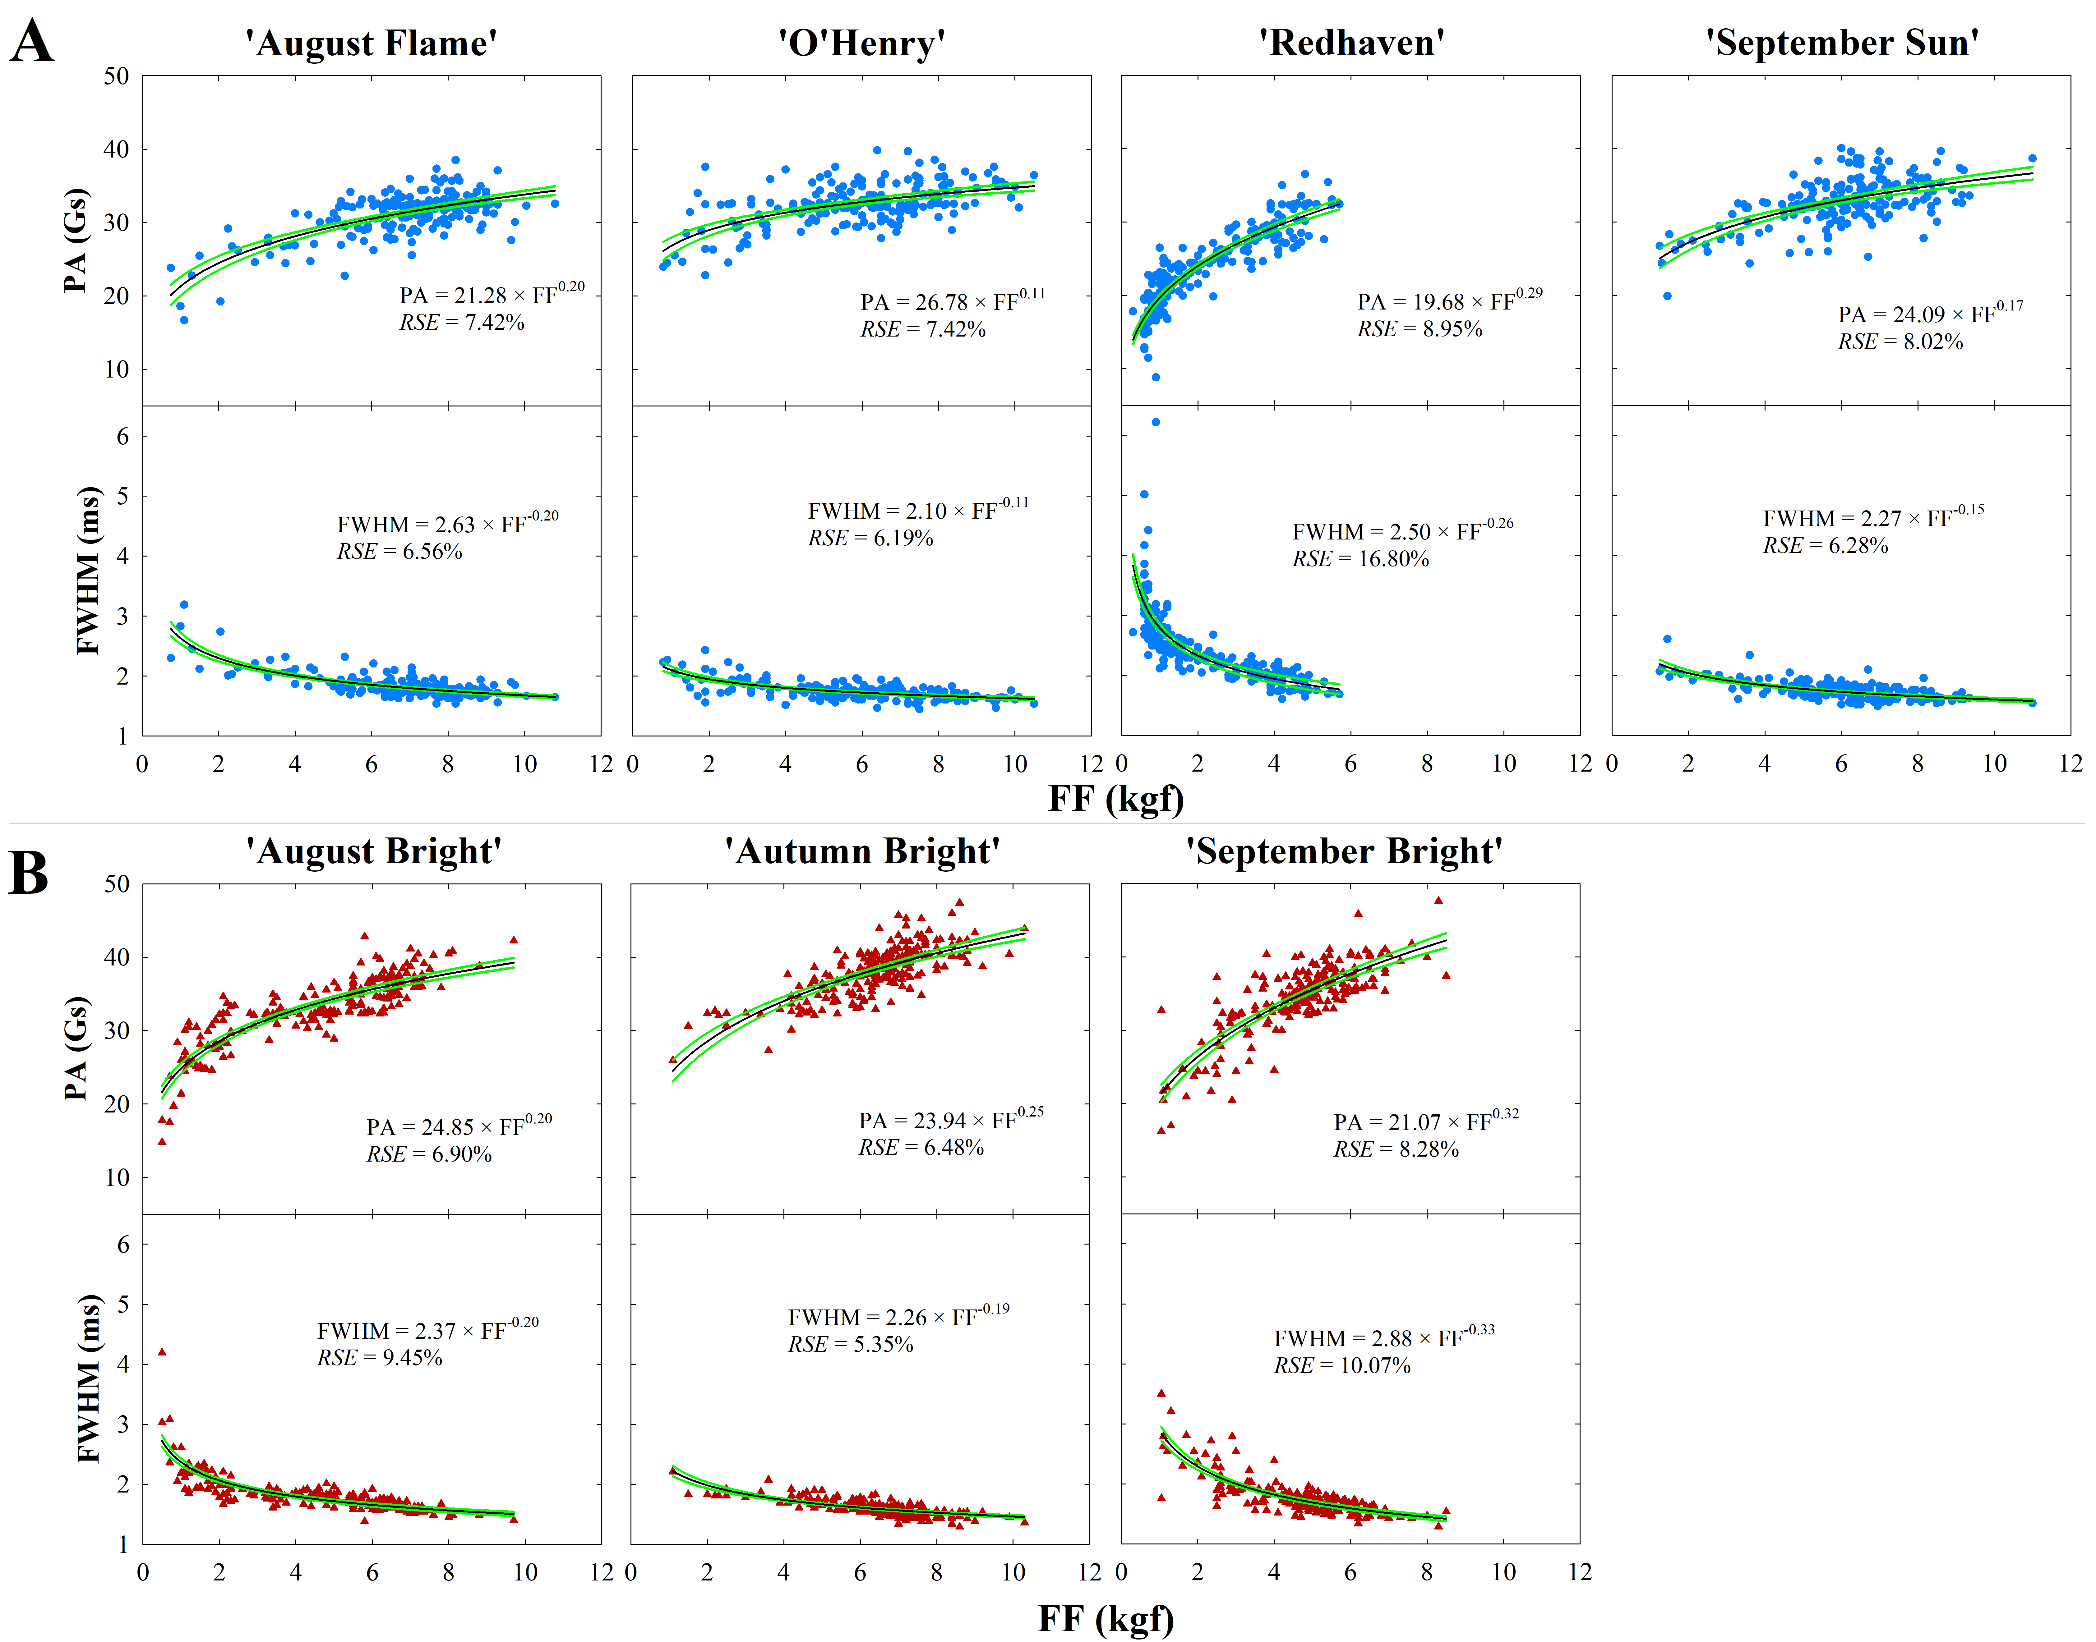
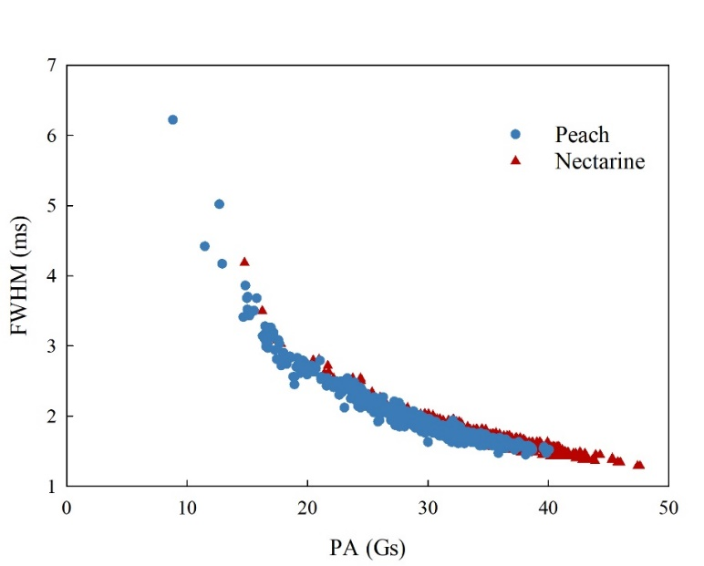
Results
Maturity indicators in peach and nectarine cultivars
PA and FWHM
Crop | Cultivar | FF (kgf) | DMC (%) | I_{AD} | PA (Gs) | FWHM (ms)
Peach | 'August Flame' | 6.88 (1.79) | 13.04 (1.95) | 1.07 (0.43) | 31.1 (3.12) | 1.83 (0.20)
 | 'O'Henry' | 5.93 (2.09) | 15.02 (2.06) | 0.88 (0.53) | 32.49 (2.90) | 1.75 (0.15)
 | 'Redhaven' | 2.34 (1.52) | 11.59 (1.32) | 0.23 (0.27) | 23.91 (5.46) | 2.43 (0.60)
 | 'September Sun' | 6.05 (1.71) | 13.79 (2.21) | 0.91 (0.45) | 32.76 (3.26) | 1.75 (0.15)
Nectarine | 'August Bright' | 4.63 (2.10) | 14.89 (2.36) | 0.23 (0.15) | 33.02 (4.56) | 1.82 (0.30)
 | 'Autumn Bright' | 6.39 (1.48) | 11.73 (1.73) | 0.57 (0.37) | 38.06 (3.53) | 1.61 (0.13)
 | 'September Bright' | 4.67 (1.43) | 14.86 (2.29) | 0.59 (0.36) | 34.35 (4.88) | 1.78 (0.32)
FF: flesh firmness; DMC: dry matter concentration; I_{AD}: index of absorbance difference; PA: peak acceleration; FWHM: full width at half maximum.
PA and FWHM were related to FF by power functions.
The predictions of FF using PA had similar errors in all the cultivars, suggesting higher precision of PA than FWHM.

Slide 4
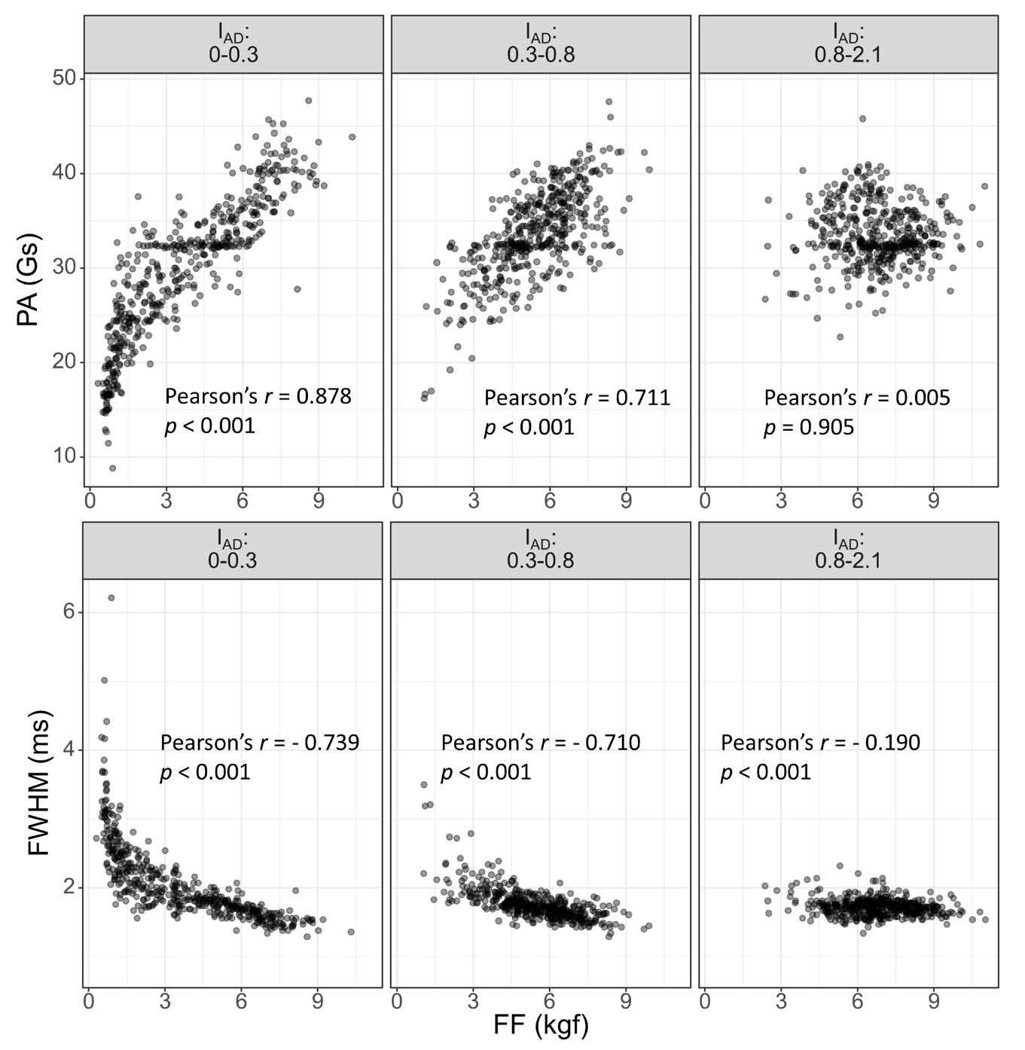
Results
PA and FWHM vs FF
The relationships of PA and FWHM with FF lost accuracy when fruit were more immature (I_{AD} > 0.8).
PA was more suitable for measurements in soft fruit and FWHM improved prediction in hard fruit, although prediction was not accurate.

Slide 5
Conclusions
The portable probe was user-friendly, reduced data collection time and avoided fruit sample destruction
Predictions for peach and nectarine’s FF were not affected by skin characteristics
The prediction of FF was best in softer fruit, suggesting suitability in the post-harvest chain
Future studies could focus on the application to softer fruit crops, such as berries
ACKNOWLEDGEMENTS
The experiment was supported by the Tatura SmartFarm stone fruit experimental orchard project (SF17006 Summerfruit Orchard – Phase II) funded by Hort Innovation using Summerfruit levy and funds from the Australian Government with co-investment from Agriculture Victoria. We gratefully acknowledge the technical support and assistance of Cameron O’Connell and Laura Phillips.

