Slide 1


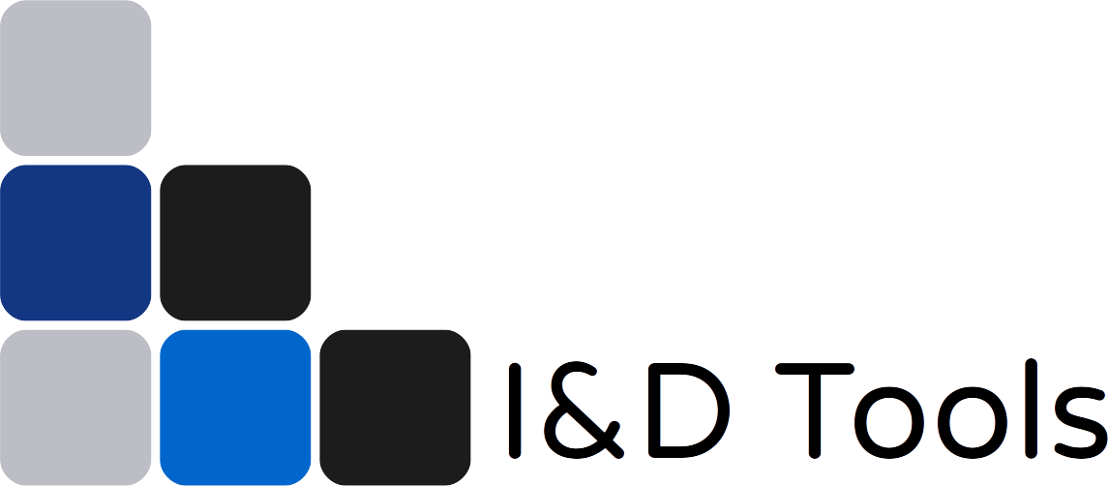

DA-meter software development
Partners:
Agriculture Victoria Research
Instrument and Data Tools (ID Tools) Pty Ltd
Summerfruit Australia Ltd

Slide 2
Instruments
& Data Tools
DASoftware
User interface for handling DA Meter data
Daniel Pelliccia
Horticulture Innovation Fund GA-F692259482,
”DA Meter software development”
idtools.com.au

Slide 3
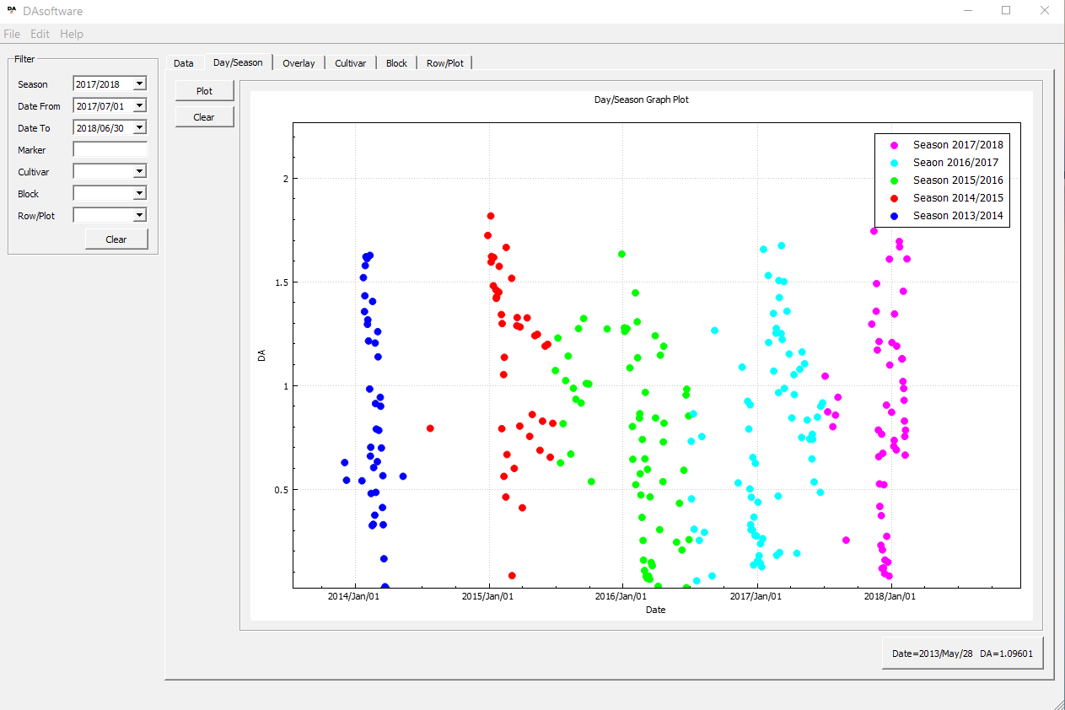
DASoftware: features
Data
  Import DA meter data
  Basic stats on the data
  Label data
  Export to Excel
Charts
  Time charts → trends
  Bar charts → comparisons

Slide 4
DASoftware: installation
DASoftware can be downloaded as a compressed (zip) folder for Windows OS.
The first time:
  Extract folder
  Run VC_redist.x64.exe
  Run DAsoftware.exe
From then on simply run DAsoftware.exe

Slide 5
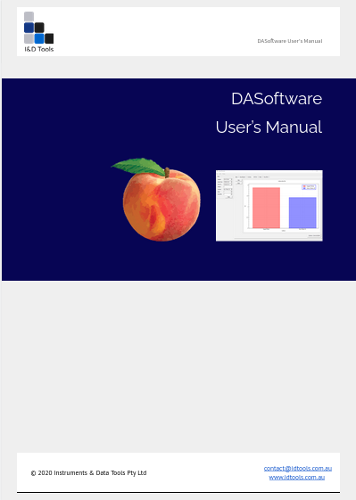
Download and user’s manual
Software and user’s manual are available for download on the HIN website http://www.hin.com.au/networks/profitable-stonefruit-research/da-software

Slide 6
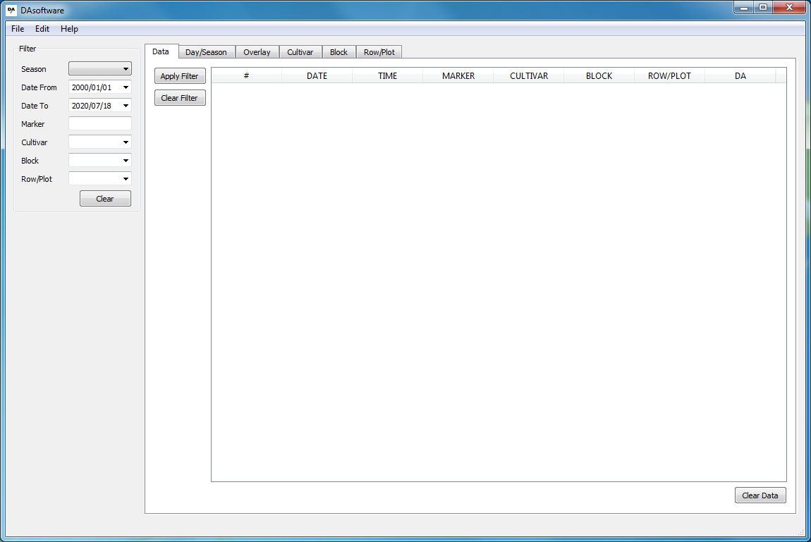
Additional pictures
Initial screen of the DASoftware

Slide 7
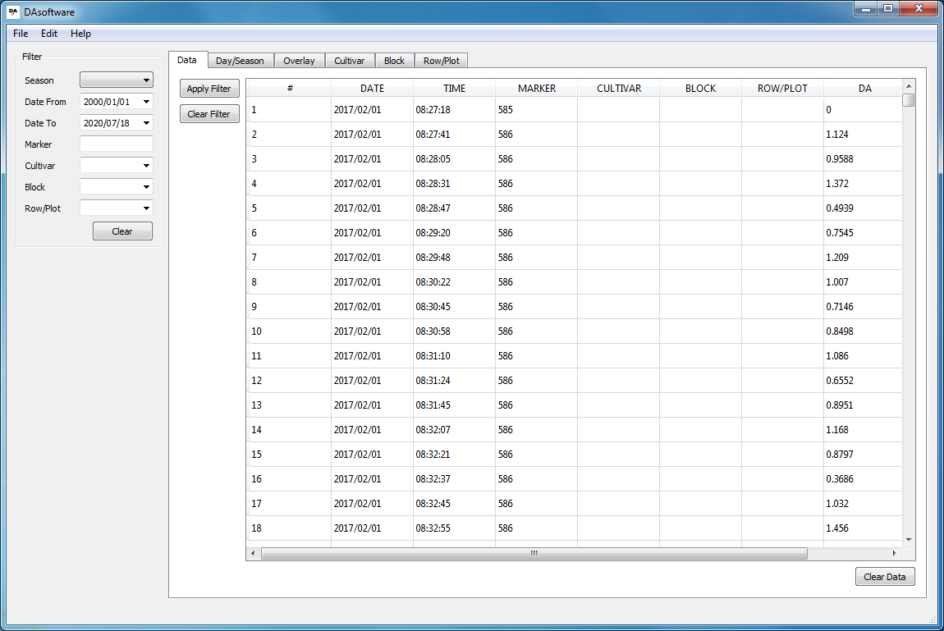
Additional pictures
DA-meter data loaded from the SD card

Slide 8
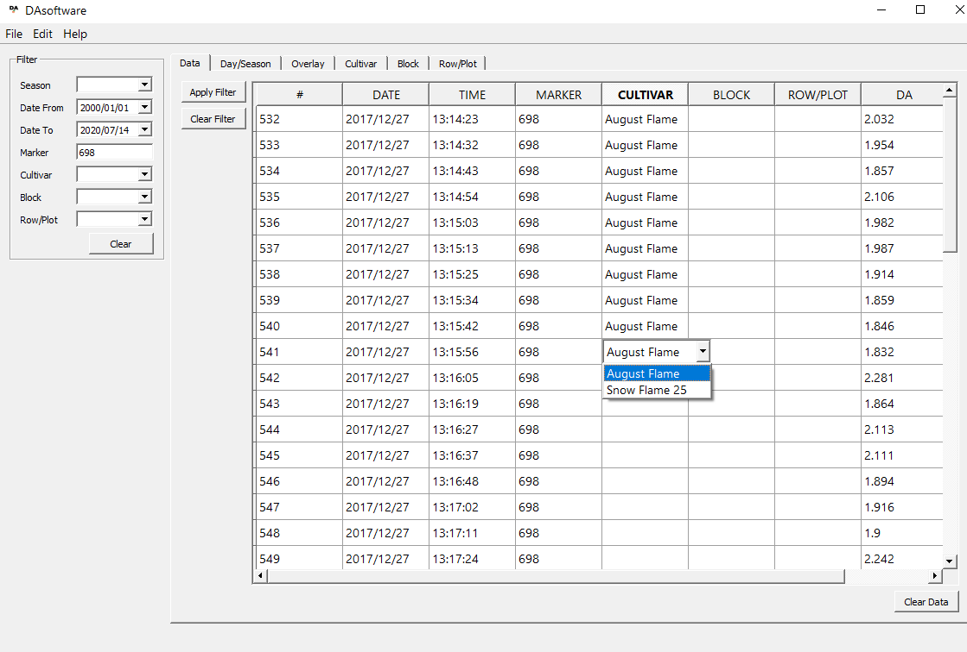
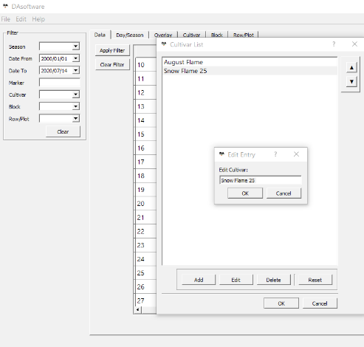
Additional pictures
Selecting cultivars

Slide 9
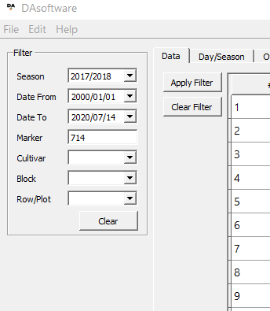
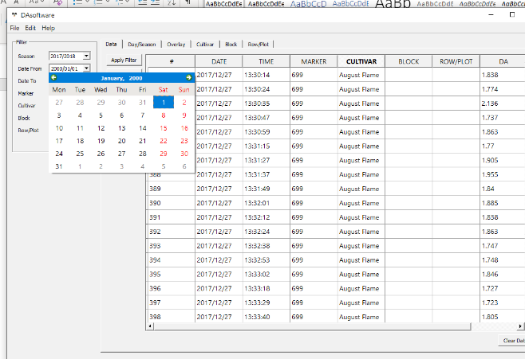
Additional pictures
Selecting date range

Slide 10
Additional pictures
Comparing DA values across seasons

Slide 11
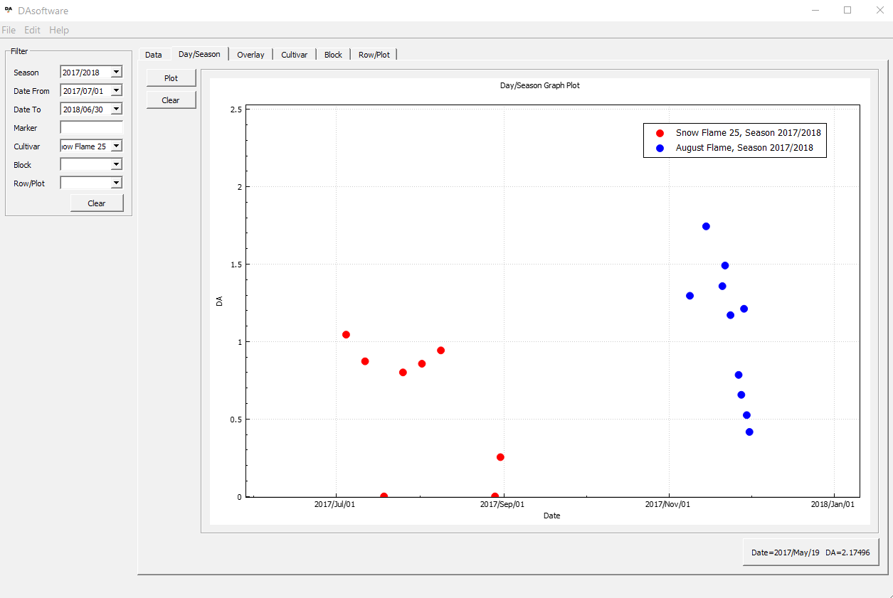
Additional pictures
Comparing DA values between cultivars

Slide 12
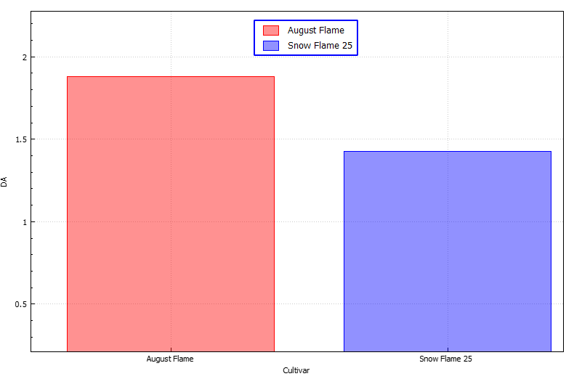
Additional pictures
Bar chart: comparing average DA value across cultivars

Slide 13
