Slide 1
Establishment of a passive insect surveillance trapping system for the processing tomato and seed potato industry

Slide 2
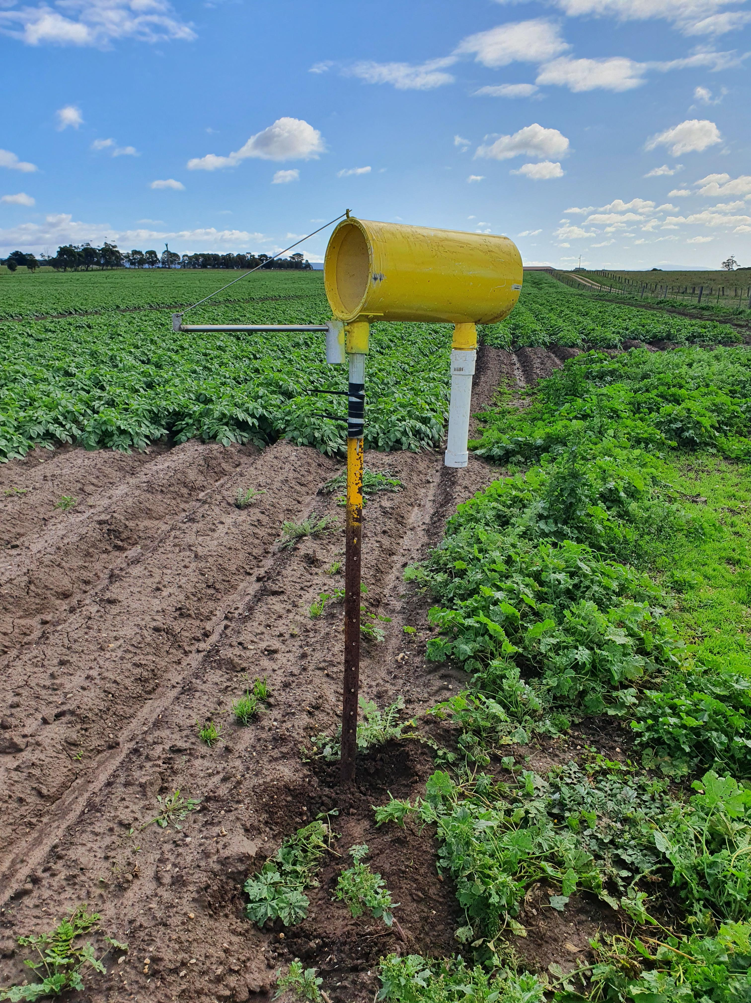
Passive Trapping Surveillance

Slide 4
Location of Trapping Network
40 traps were equally split between the processing tomato and seed potato properties.
Processing tomato properties - Corop, Rochester, Boort/Kerang, Lake Boga and Echuca West.
Seed potato properties were located at Gippsland, Ballarat (x2), Otways and Portland.

Slide 5
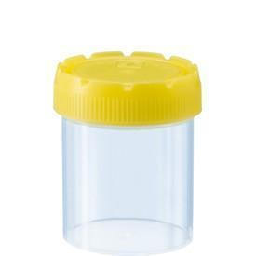
Collection and Preservation Liquid
40% propylene glycol

Slide 6
High Throughput DNA Technology
Development of technology in Victoria has been delayed
Samples will be stored for future use at AgriBio
Industry currently in negotiation with labs in South Australia and Overseas

Slide 7
Future Opportunities
Discussions are currently underway with Tim Hurst, Senior Officer – Plant Surveillance Design and Analysis, Biosecurity & Agriculture Services, Agriculture Victoria

Slide 8
Acknowledgements
Growers who trialled traps on their properties
Funding:

