Slide 1
Pre and post-harvest management of fruit maturity and quality for market access
Dario Stefanelli
Christine Frisina, Janine Jaeger, John Lopresti, Rod Jones, Bruce Tomkins, Alessando Ceccarelli

Slide 2
Issues
Stagnant market for fresh fruit
  Price stasis
  Need to differentiate during marketing
Need to increase export
  Market selection especially in Asia
Importance to cater to consumers
  High consumer dissatisfaction
  Retailers dictate quality

Slide 3
Value Chain System approach to Quality
Determines the quality
CONSUMER
Field - Harvest
Packaging
Storage
Retailer

Slide 4
Value chain system – Industry focused
Needs to have a common language (comparable measurements) to base decisions on at each chain step
Guarantees consistent quality
Increases profitability (access to high quality markets)
Improves consumer satisfaction (delivery of consistent and preferred quality)

Slide 5
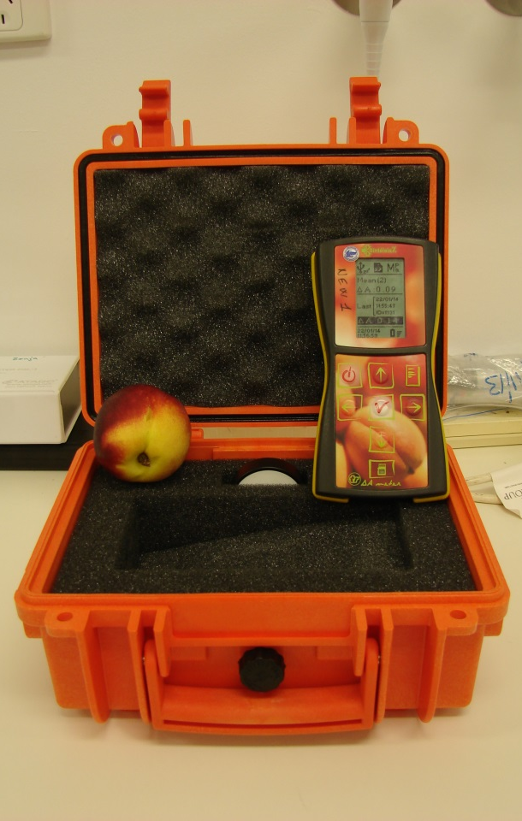
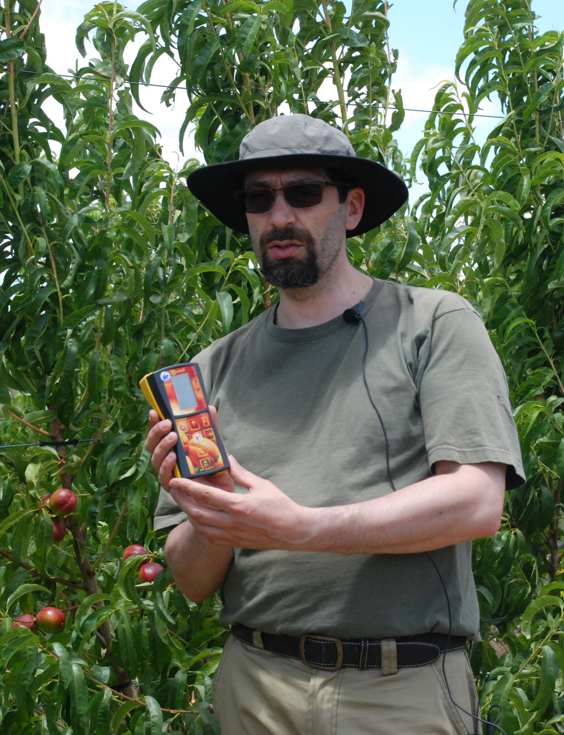
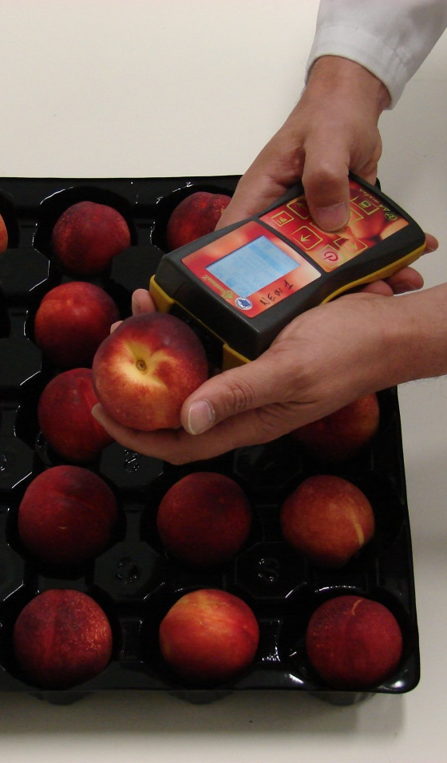
I_{AD} in Pre- and Post-Harvest
Common measurement along the value chain

Slide 6
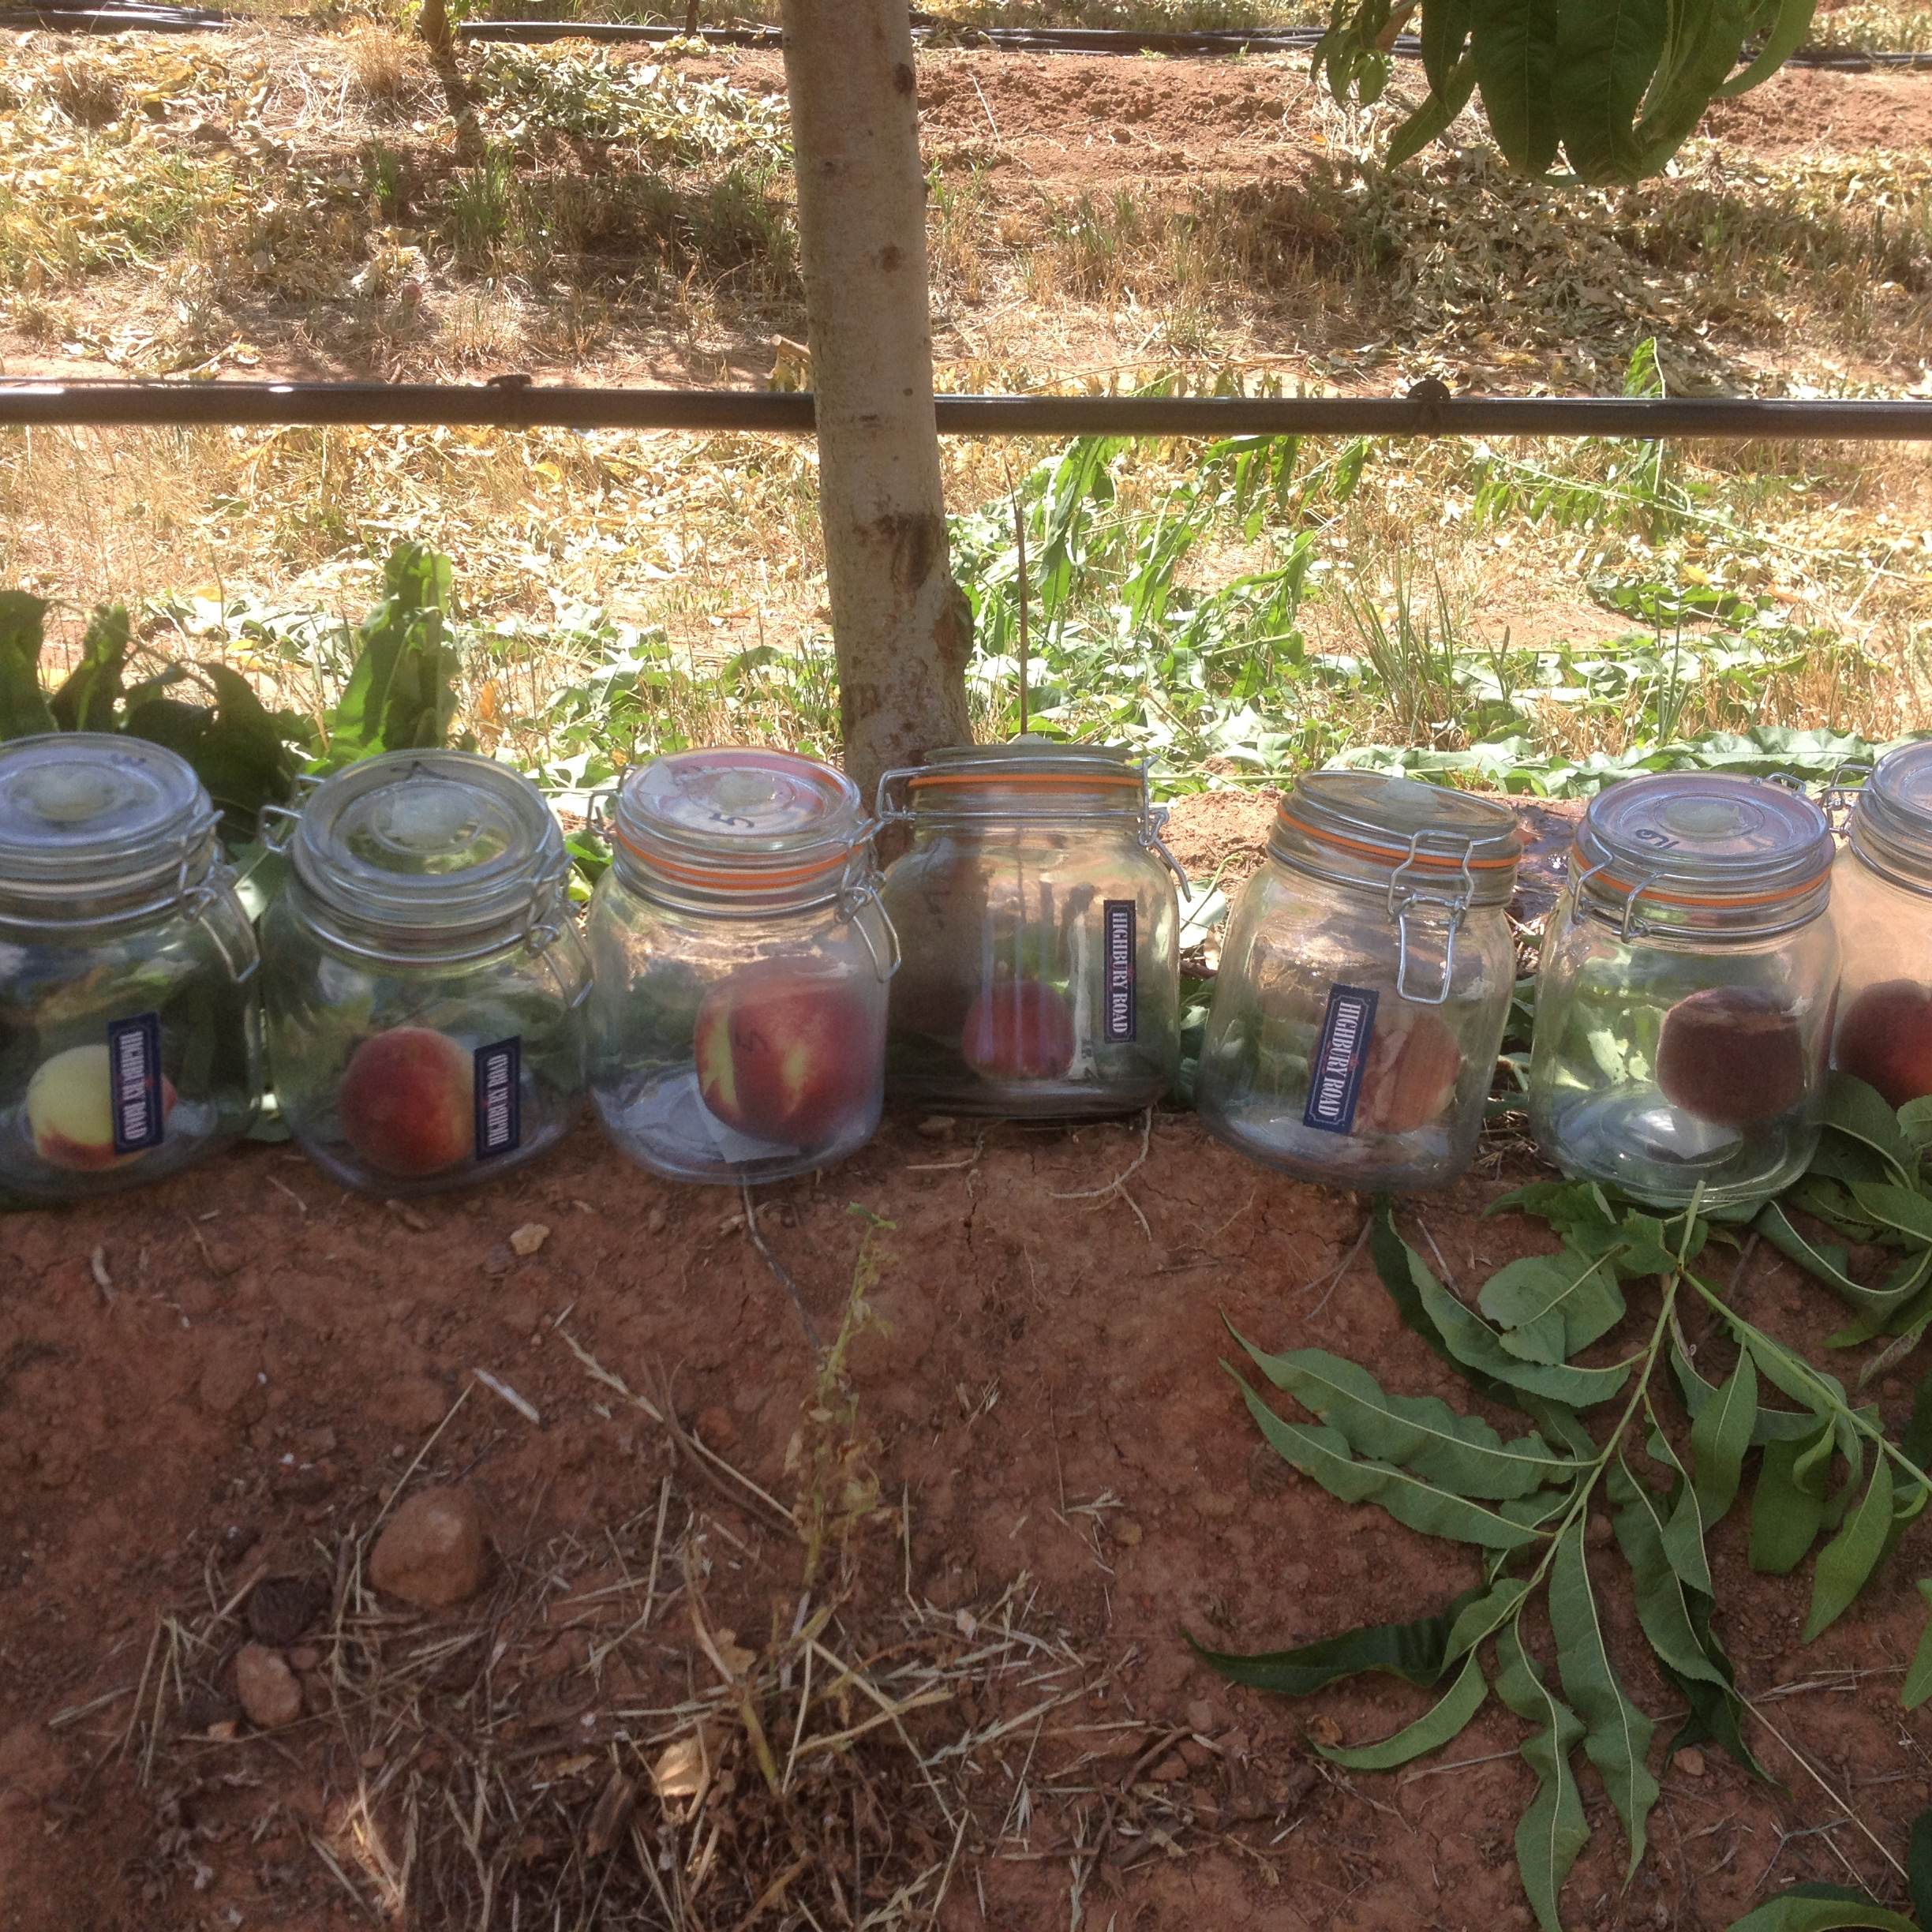
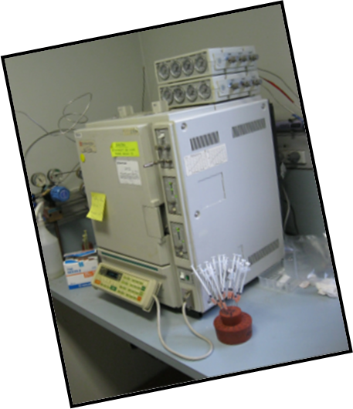
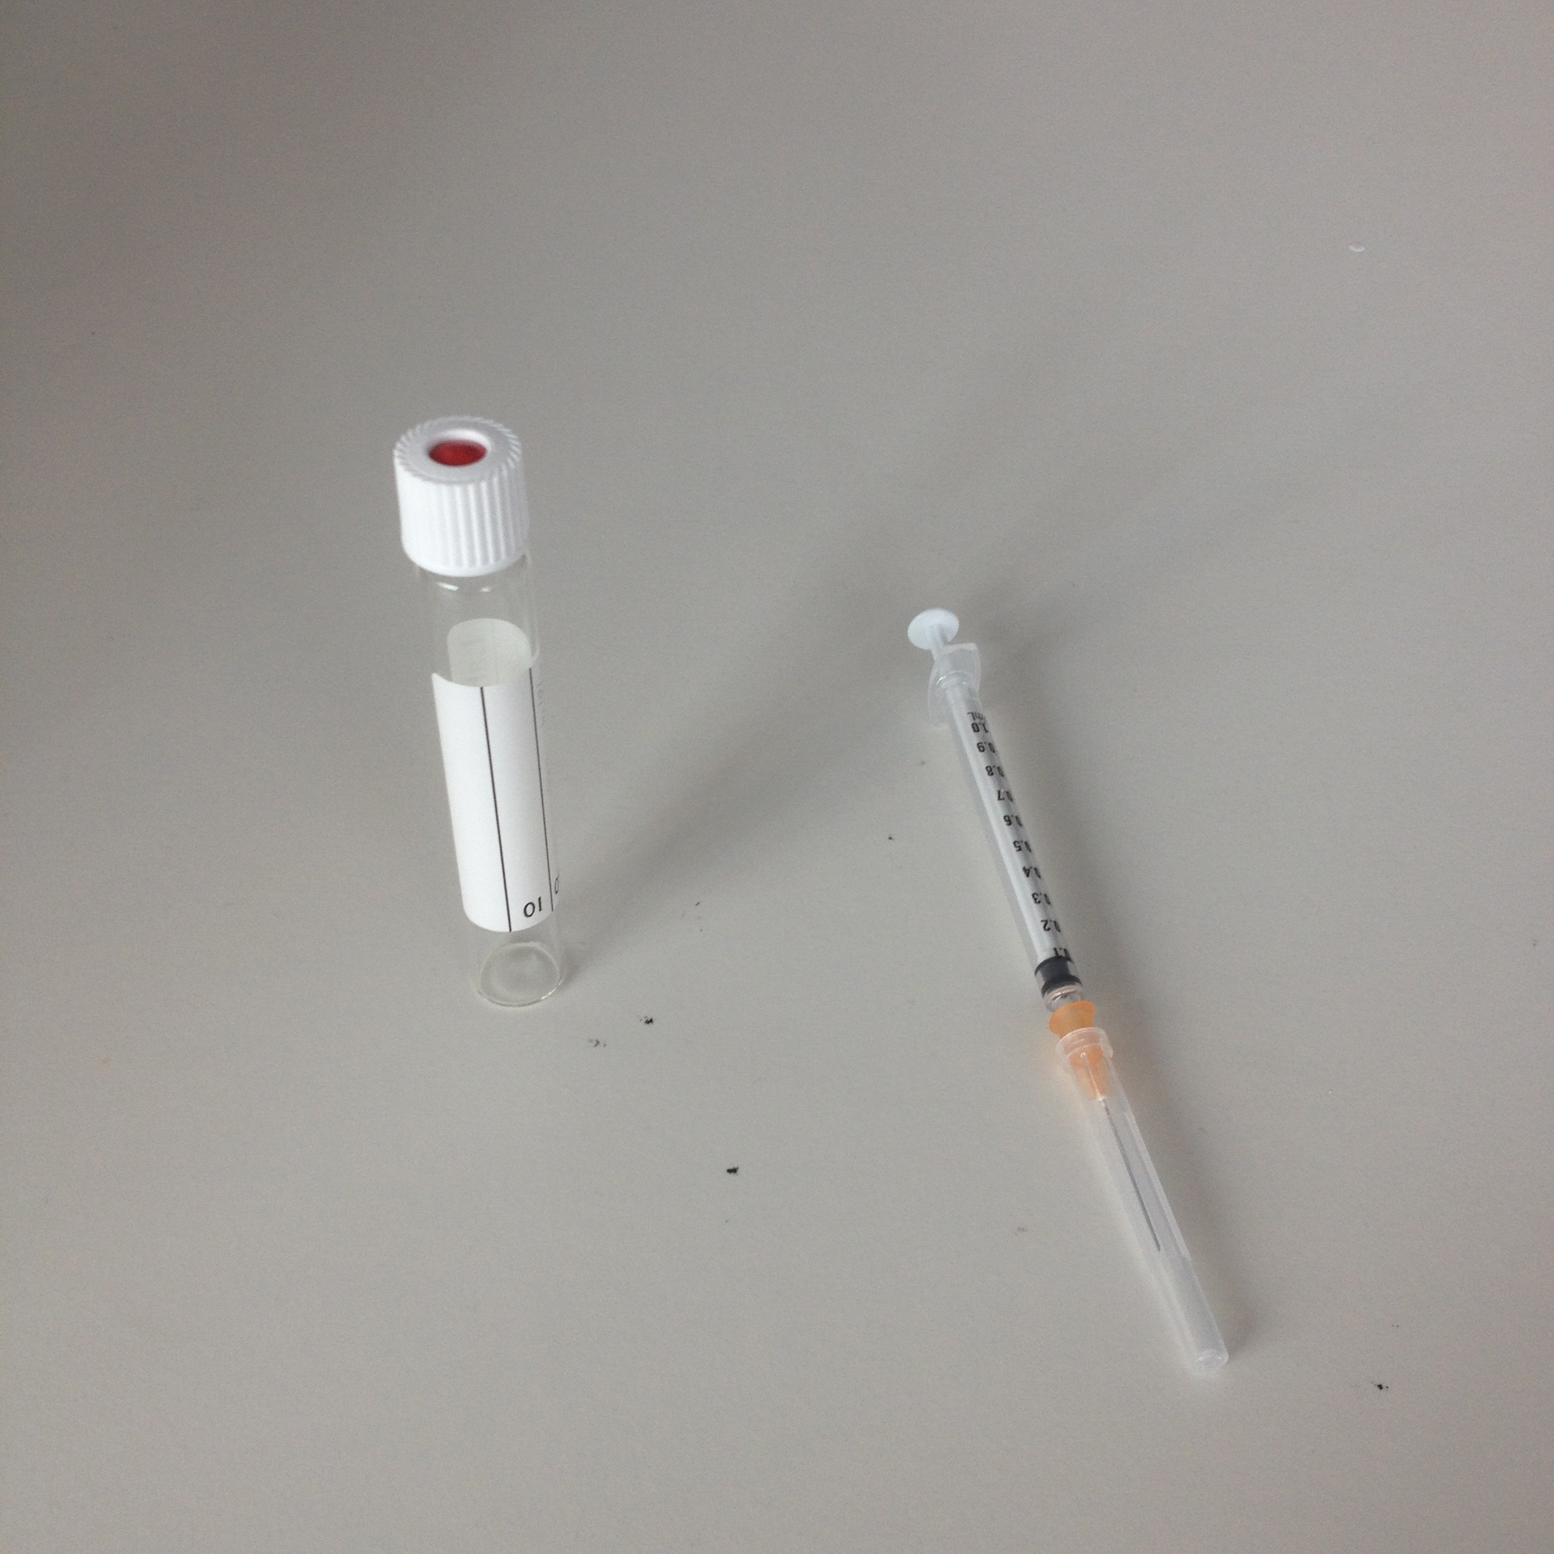
Correlation with ethylene
Maturity classes (optimal harvest – Market Specific)
Variety Specific
Can be done in the field (New protocol)

Slide 7
August Flame peach I_{AD} field development depending on tree architecture (optimal Harvest)

Slide 8
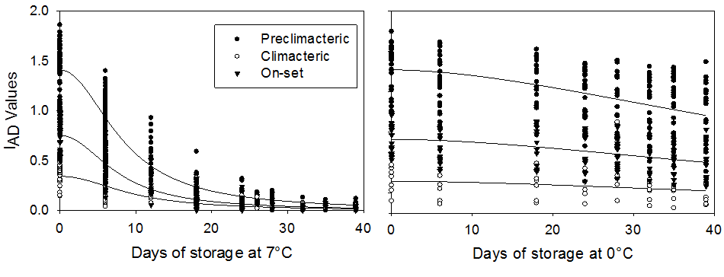
September Sun at 0 °C and 7 °C
(Predicting optimal storage length)

Slide 9
Fruit Volatile and Aroma Development
Important for Asian Markets
Fundamental aspects of fruit taste
Intact fruit (consumer odour perception in shelf)
Christine Frisina PhD (RMIT)
Fruit pulp (consumer aroma perception at first bite)
Alessandro Ceccarelli PhD (University of Bologna and RMIT)

Slide 10
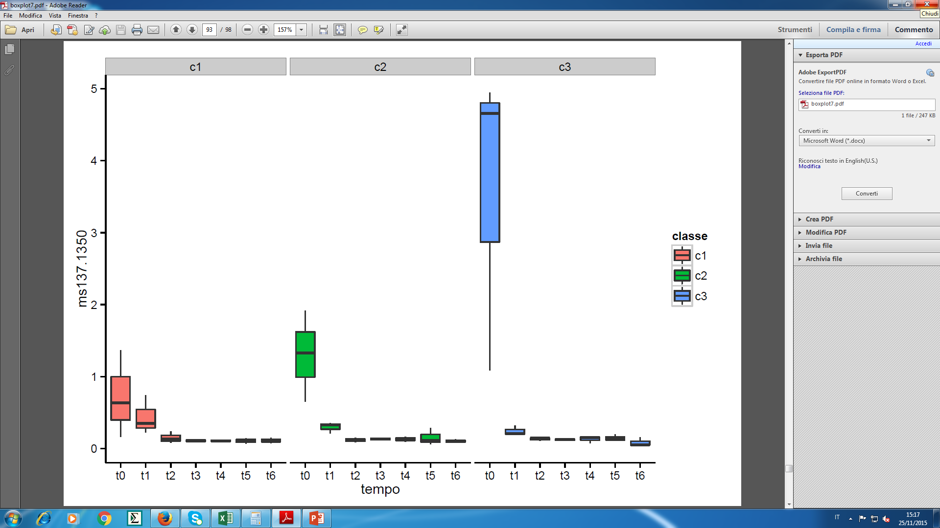
‘‘Terpen’’
Floral,
Spicy odour,
Important in
essential oils

Slide 11
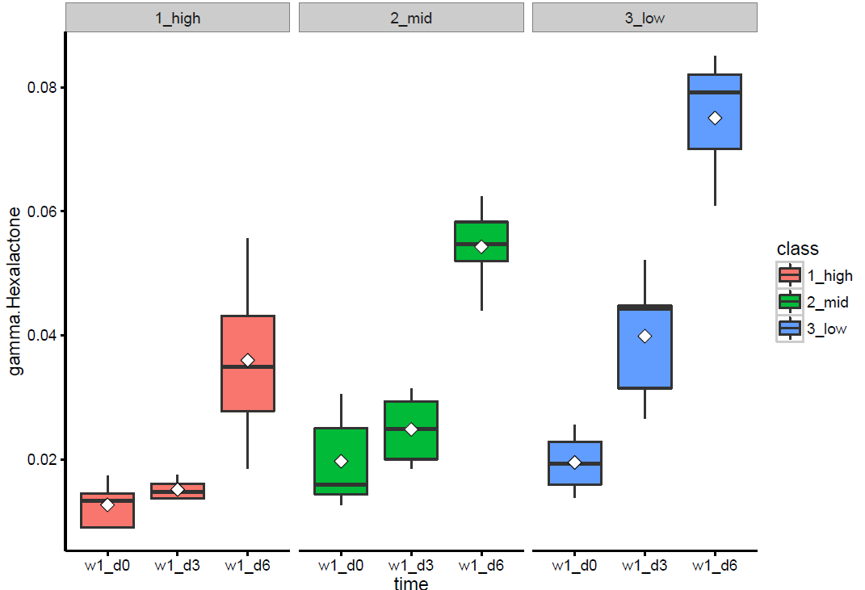
‘‘Lactones’’
Peachy component

Slide 12
How do we make quality matter?
Using a “Value chain” consumer centred approach
Connecting and correlating agronomical practices and physiological parameters (protocols in pre- and post-Harvest)
Technology (I_{AD} , NIR, electronic noses)
Creating predictable and reliable models and systems

Slide 13
Future Goals
Variety calibration for the DA-Meter
Validation and new protocol creation for different species (pre and post harvest)
Correlation of I_{AD} values with other physiological, molecular or health parameters
Consumer responses to fruit quality affected by storage length and maturity
Value Chain fully predicting model

Slide 14
DA Technology
Allows rapid and accurate measurement of fruit maturity along the whole chain providing consistent quality fruit that meets consumer expectations and improves profitability
Allows to build a brand of guaranteed quality

Slide 15
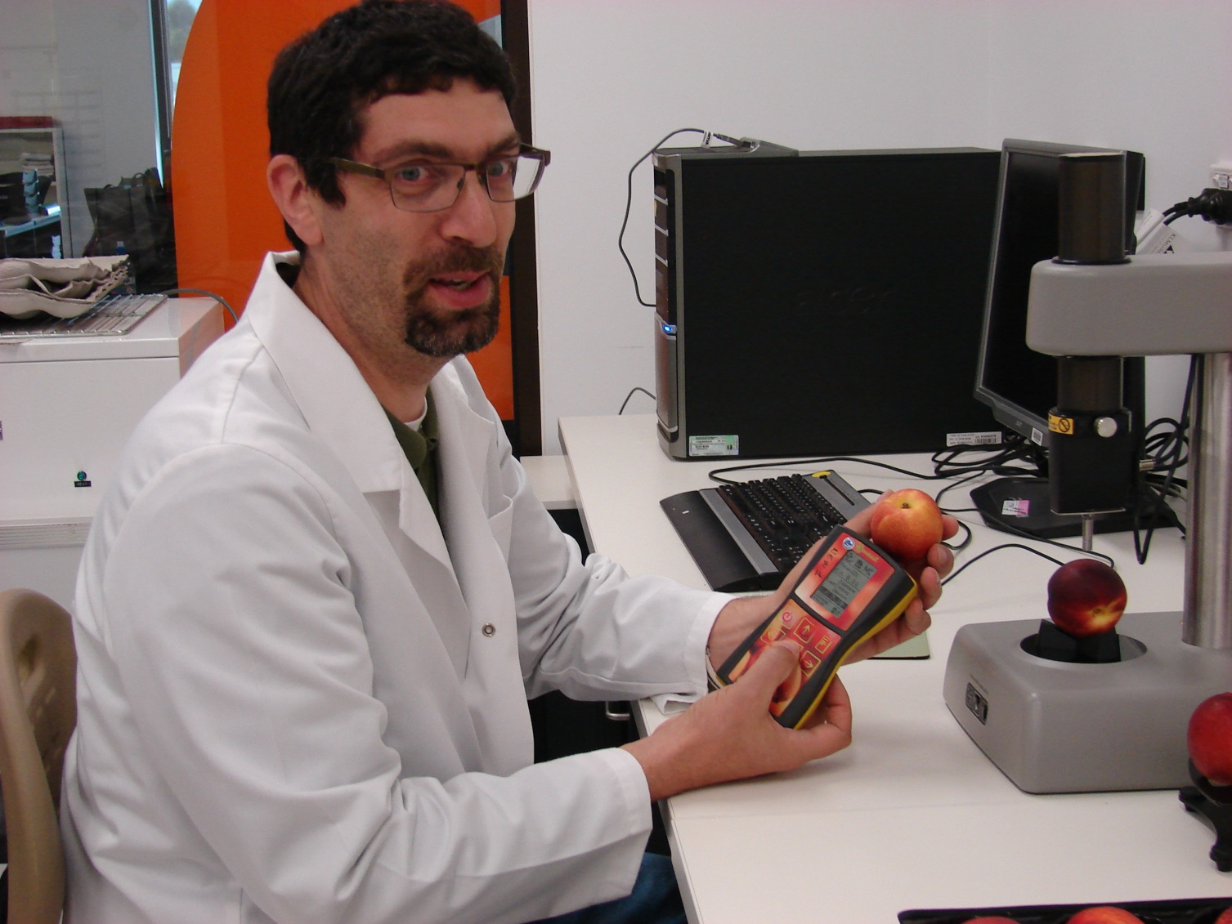


Thanks to:
Growers
Colleagues
International
Students
Funding:
Sooo! Questions?

