Slide 1
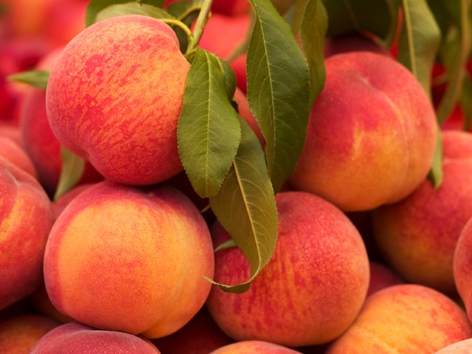
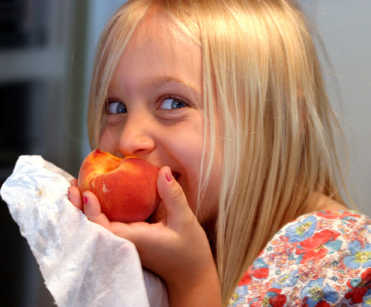
Capitalising on the importance of fruit maturity through innovative technology
Dario Stefanelli, John Lopresti, Christine Frisina, Glenn Hale, Rod Jones, Janine Jaeger, Bruce Tomkins

Slide 2
Layout
Introduction
New technology
Fruit maturity
Conclusions

Slide 3
Introduction - Background
Stagnant market for fresh fruit
  Price stasis
  Need to differentiate during marketing
Need to increase export
  Market selection especially in Asia
Importance to cater to consumers
  High consumer dissatisfaction
  Retailers dictate quality

Slide 4
Consumer Dissatisfaction
Poor and/or inconsistent fruit quality has been shown to deter customers from return purchases for up to 3 weeks with significant loss in profits for the affected industry
Consumer expects consistent quality

Slide 5
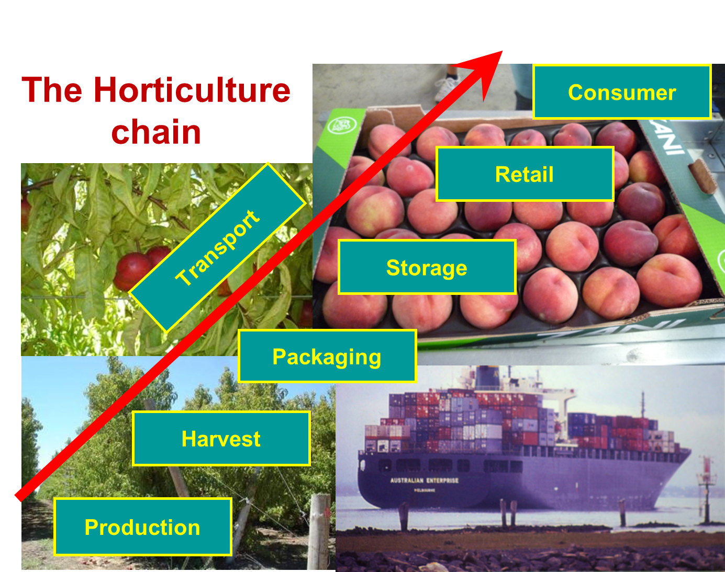
Introduction – Commercial supply chain

Slide 6
Introduction – Value chain in Horticulture
Normally “value added”
Horticulture “value maintained”
  It is decided in the field at harvest and can only be maintained. GOAL is to do not lose quality.

Slide 7
Value Chain System approach to Quality
Determines the quality
CONSUMER
Field - Harvest
Packaging
Storage
Retailer

Slide 8
Value chain systems approach
Needs to have a common language (comparable measurements) to base decisions on at each chain step
Guarantees consistent quality
Increases profitability (access to high quality markets)
Improves consumer satisfaction (delivery of consistent and preferred quality)

Slide 9
What can be used as index of quality?
Most common:
  Size
  Soluble Sugars
  Firmness
  Sugar/Acid (index of consumer preference)
Problems:
  Destructive and/or sampling batches, representativeness
  If non destructive: NEED constant calibration
  High variability

Slide 10
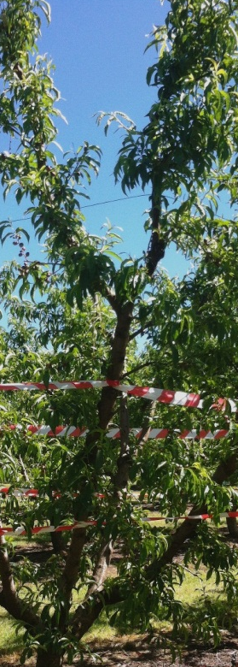
Fruit quality by crop load and position
‘Low’ ‘Commercial’ ‘High’
Percentage of
fruit >110 grams
and >7% SSC
-cv. Rose Bright
-Single harvest (94 DAFB)
-Elberta rootstock
- 4.5 m trees
- Cobram
100%
97%
100%
96%
68%
79%
78%
39%
42%
44%
18%
25%
Notes:
3 crop loads
Mean percentage refers to number of fruit at each height/ scaffold limb meeting the quality criteria of >110g in weight and >7% SSC
Low crop load increased quality at all heights except top (high leaf-to-fruit ratio at top of all trees)
Less than half of fruit met quality specs at bottom of tree in Low crop load
Key message: Lower crop load improved quality but improvements were less further with decreasing tree height
Emphasise difficulty in improving quality lower in the tree

Slide 11
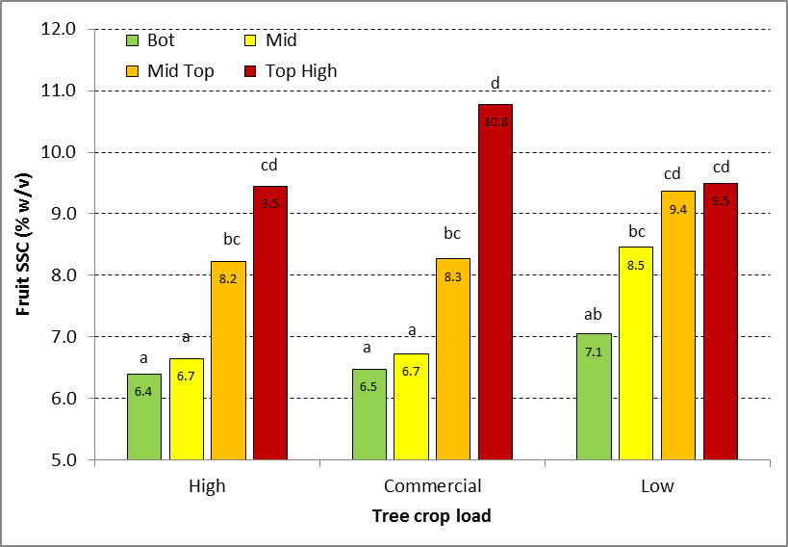
Crop load, height and fruit SSC
All fruit were tree-ripened – Each bar represents the average of 30-40 fruit
Notes:
Similar trend to fruit size BUT:
But Low crop load didn’t not significantly improve SSC in bottom fruit; no difference at top of tree
Changes in crop load seem to have greater effect of fruit size than SSC in this early cultivar…

Slide 12
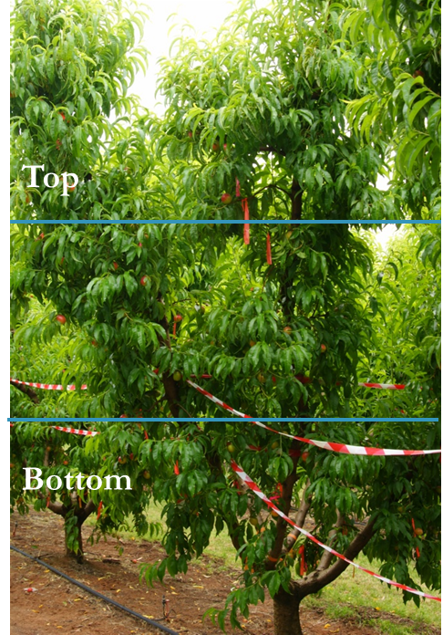

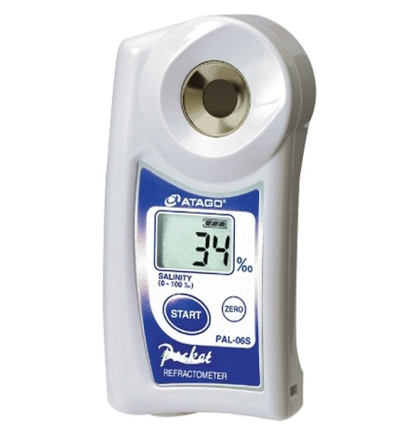
Soluble solid content (°Brix)

Slide 13
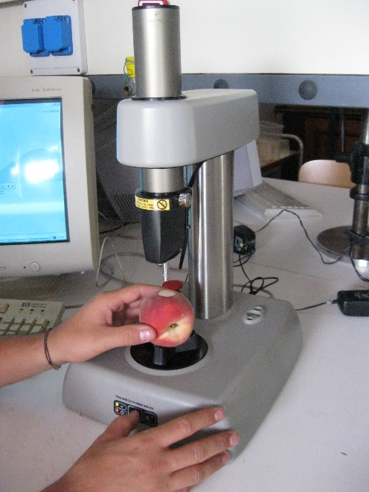
Flesh Firmness (Kg∙cm⁻² )
Flesh firmeness did not show differences between crop loads!!

Slide 14
Fruit Maturity:
The DA (Difference of Absorbance) Technology
Based on vis/NIR spectroscopy
Measures Chlorophyll-a content in mesocarp (difference between 720 and 670 nm)
Index of fruit physiological maturity stage
It is proved for climacteric fruit (stone and pome)
Notes:
Brief introduction on the working of the DA technology. Importance on the Physiological stage of the fruit

Slide 15
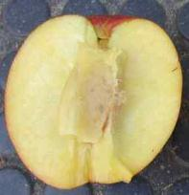
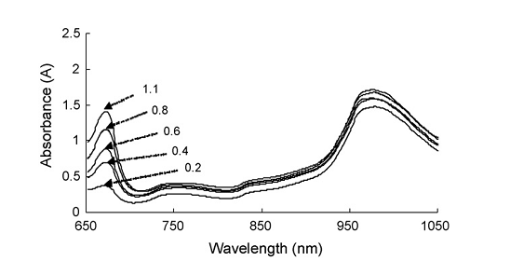
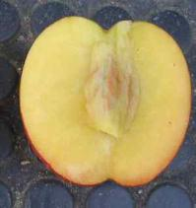
I_{AD} Index as indicator of maturity
In climacteric fruit chlorophyll content decrease during ripening
Notes:
Correlation with Chlorophyll a and to show that lower number higher maturity. Could remove if you need to.

Slide 16
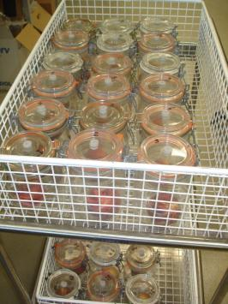
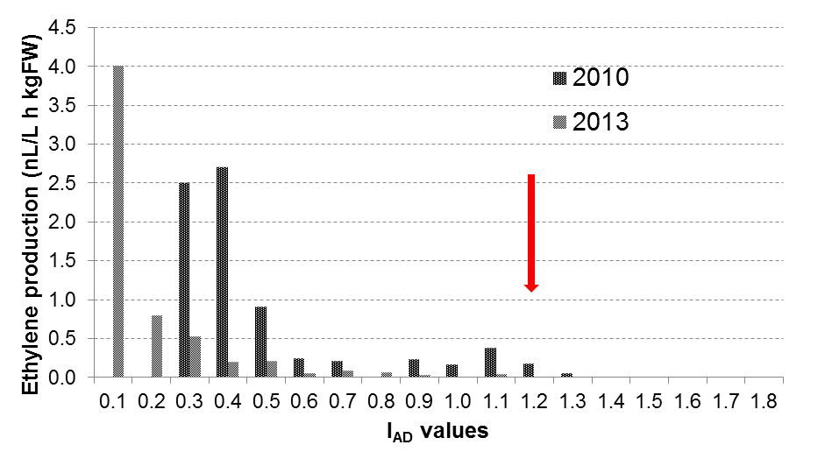
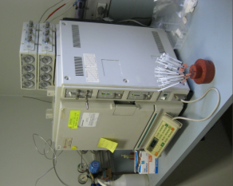
The I_{AD} is related to the time course of ethylene production during fruit ripening
I_{AD} classes and ethylene production per variety are constant every year; it is cultivar specific
Summer Flare 34 nectarine
Climacteric
On-Set
Pre-Climacteric
Notes:
Correlation with ethylene. Show work with GC and results to decide classes. Emphasis on the similar behaviour of fruit in each class and why we segregate fruit by class and not by single DA vlaue.

Slide 17
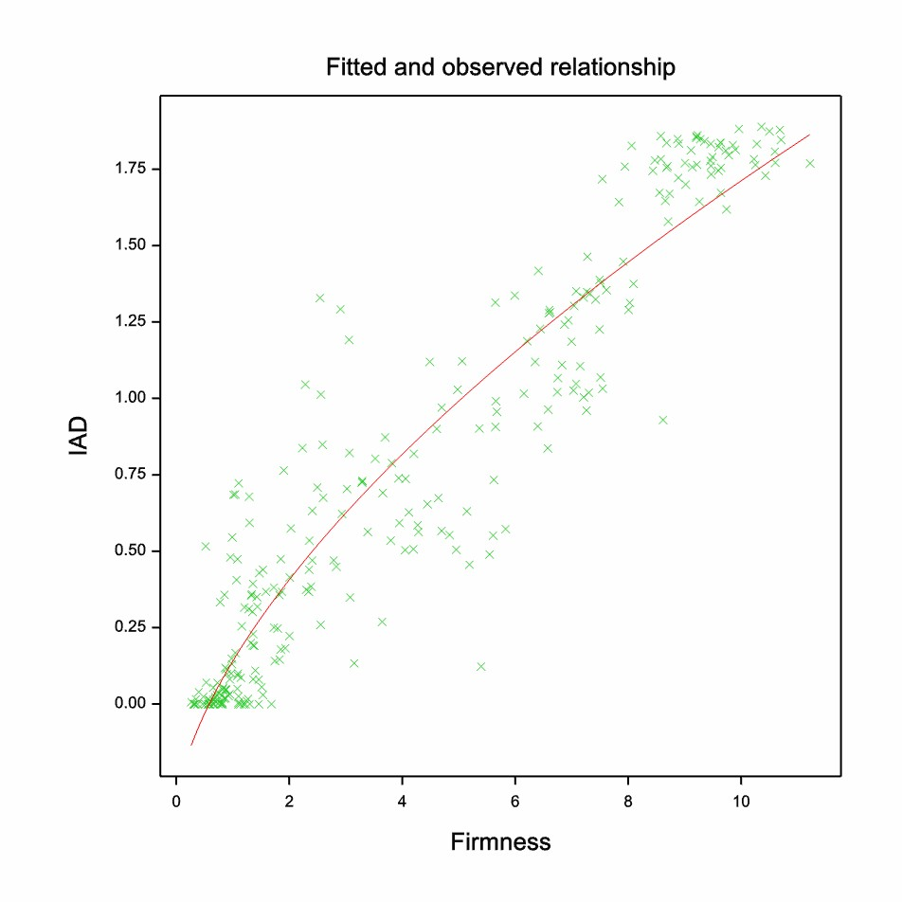
Correlation with classical destructive measurements Williams
R² = 0.88

Slide 18
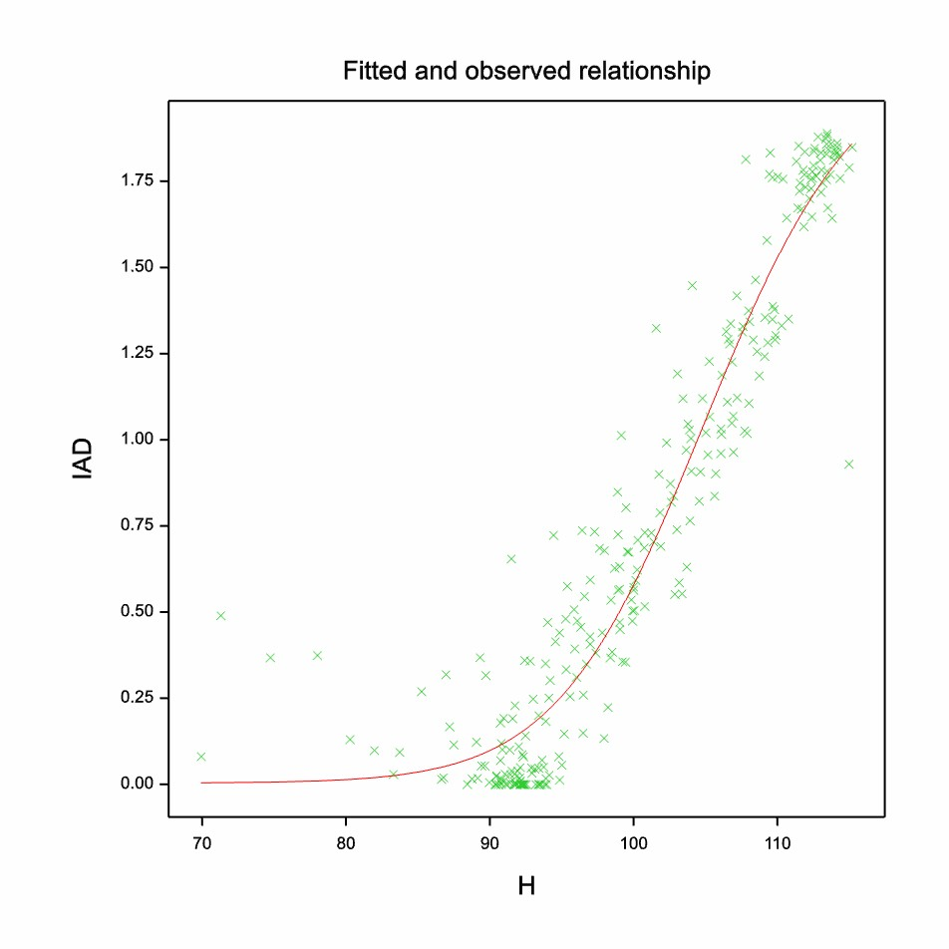
Correlation with classical destructive measurements Williams
R² = 0.93

Slide 19
Nectarine September Red
r² = 0.52; p<0.001

Slide 20
Maturity monitoring in the field 2014
Williams
Lanya

Slide 21
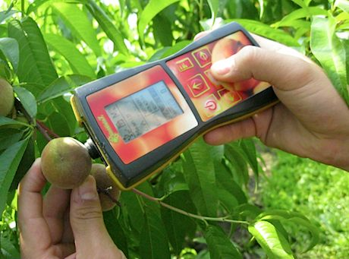
Usefulness in the field (pre-harvest)
Notes:
To show that in the field it is possible to understand and adapt agronomical inputs, such as labour depending on the tree variability. DA can measure the variability.
This shows that Tatura trellis did not have any variability in maturity along the canopy.

Slide 22

Understand the orchard
Notes:
This is a continuation of the preious slide but on a vase there is variability and needs to be accounted in the orchard management

Slide 23
Understand the orchard
Notes:
Similar concept in crop load. It does have an effect on maturity. Growers need to know their orchards and if they have patches or trees that for whatever reason have less fruit than others then they will be maturity at different stages. Again it helps in orchard management.

Slide 24
Predict harvest date
Days After Full Bloom
Notes:
This just to say that it is possible to predict harvest date because after IAD 1.8 stone fruit ripens in a straight line, therefore it is possible to predict it. How early it can be predicted depends on the variety calendar of maturity along the season

Slide 26
Predict harvest date and storability.
Royal Gala
Irrigation trial
Notes:
This is to show that it is possible with other fruit as well. This case on Gala. The different lines are irrigation volumes. Not so important aside to say that if trees or patches in the orchard are drier or wetter than others, then the ripening will be affected. Also the horizontal lines tell the separation between maturity classes and the supposed length of storage that would be affected by the time of harvest. Up to you if you want tot eliminate one of the two on ripening prediction.

Slide 27
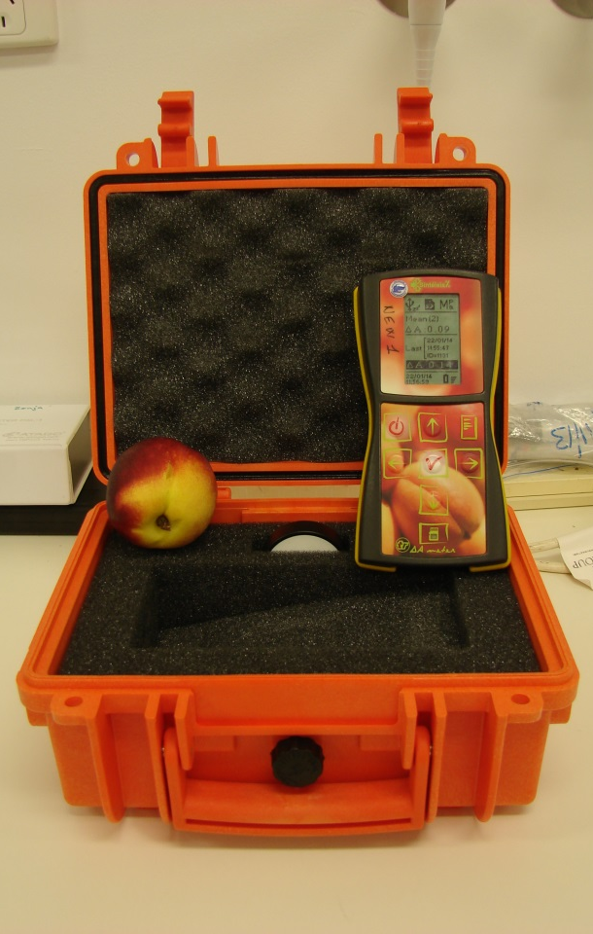
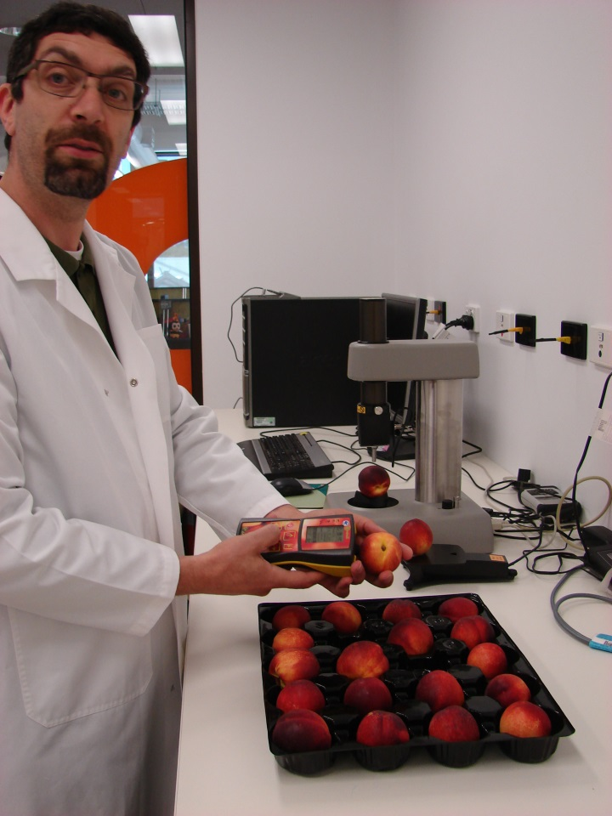
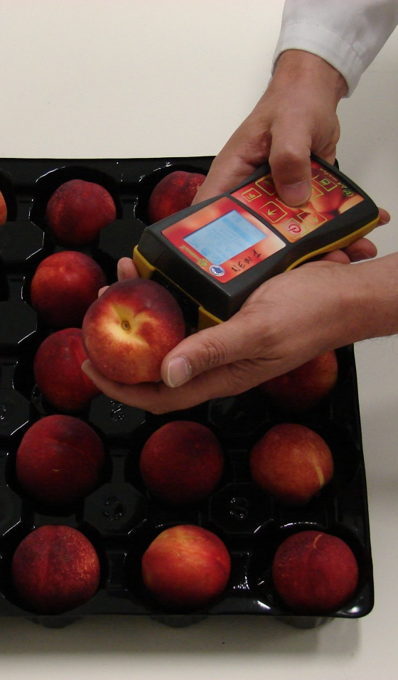
I_{AD} Measured for Postharvest evaluations

Slide 28
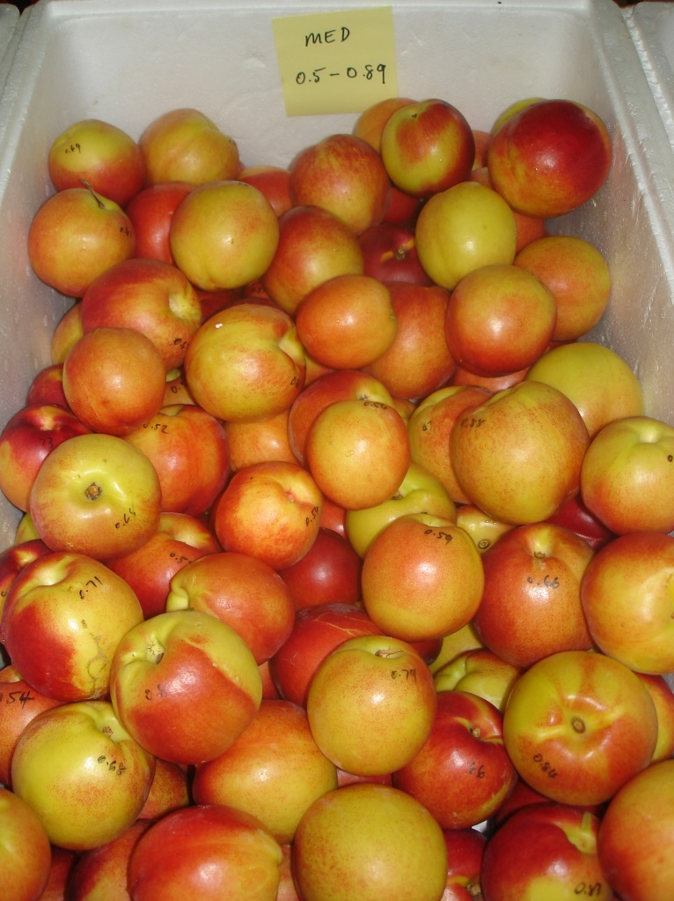
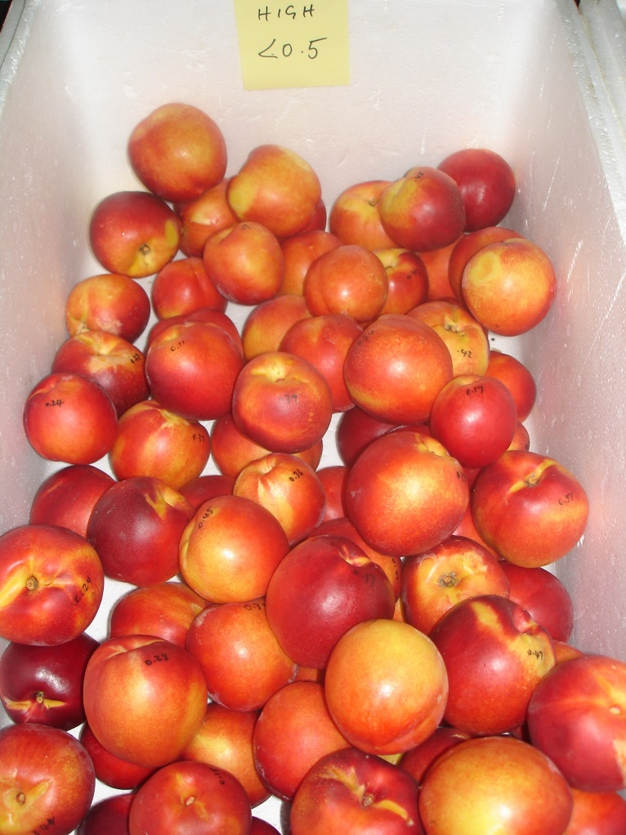
Fruit segregated by I_{AD} Value

Slide 29
I_{AD} Shelf life Lanya 2015

Slide 30
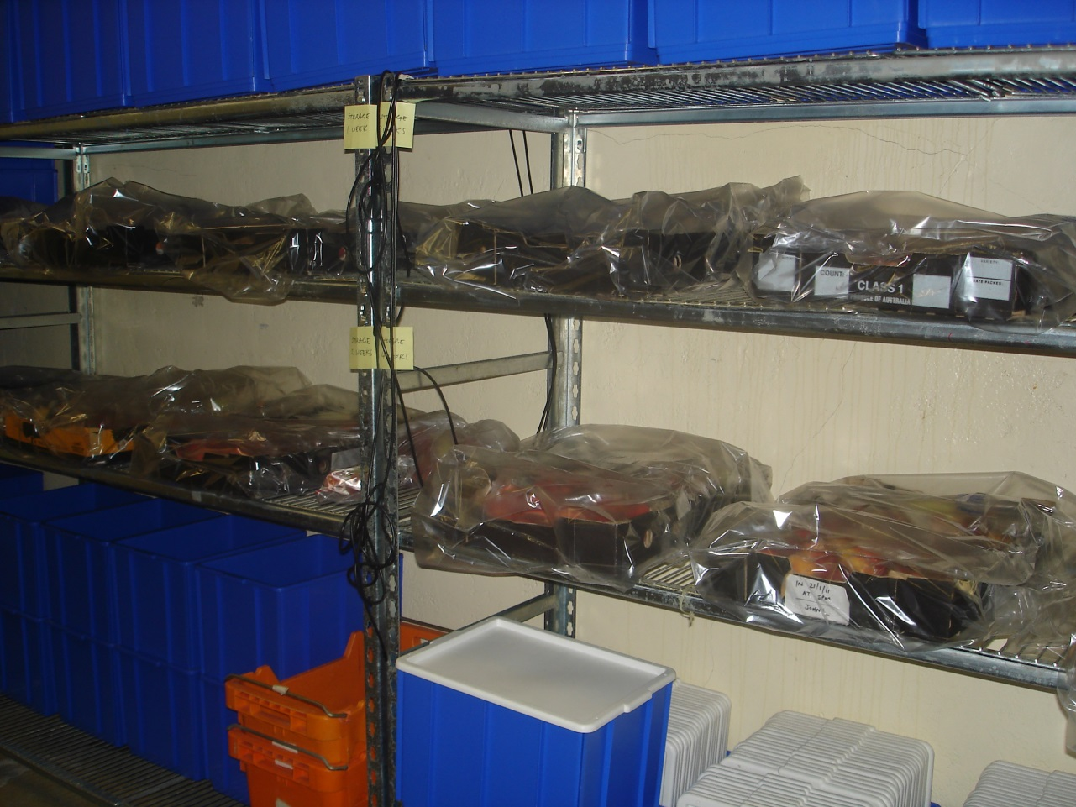
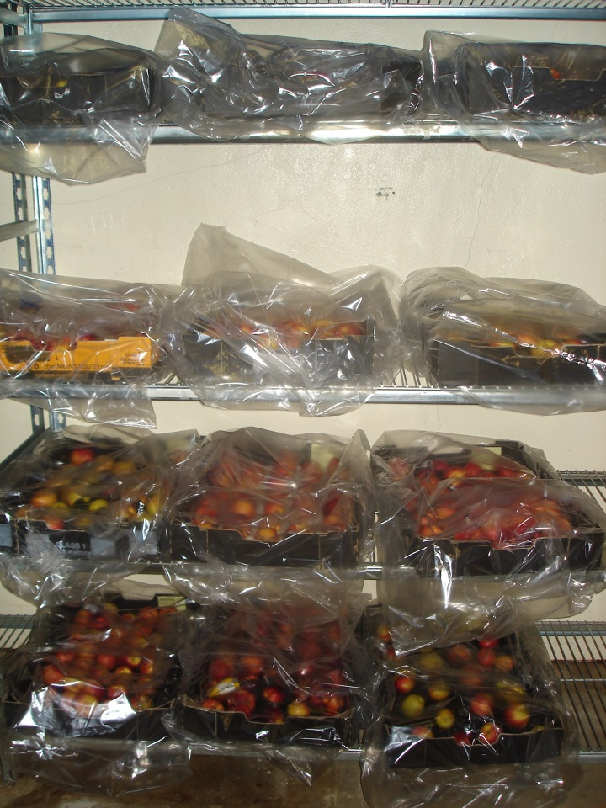
Fruit stored at either 0, 7 or 18 °C

Slide 31
Best fitting curve by SigmaPlot 12.5
Maturity class and storage T as sub-data sets within each variety
Used Global Curve Fitting option
Parameter “b” (curve slope) shared between sub-data sets

Slide 32
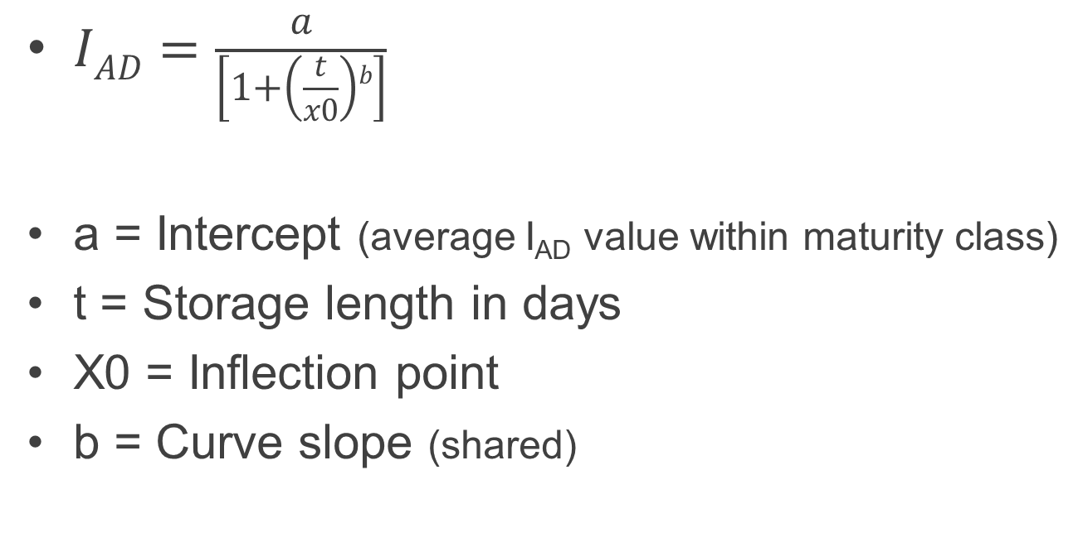
Best regression: sigmoidal following a logistic model with 3 parameters
$IAD=\frac{a}{\left[1+\left(\frac{t}{x0}\right)b\right]}$
a = Intercept (average I_{AD} value within maturity class)
t = Storage length in days
X0 = Inflection point
b = Curve slope (shared)

Slide 33
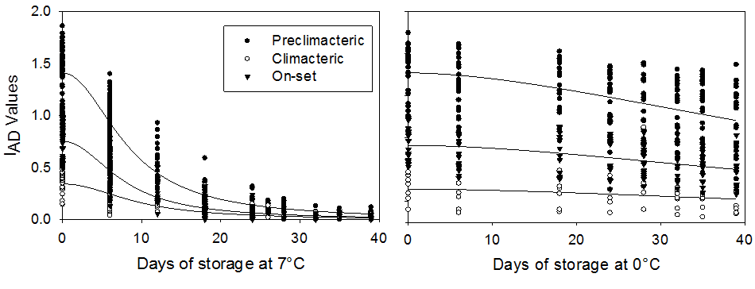
September Sun at 0 °C and 7 °C

Slide 34
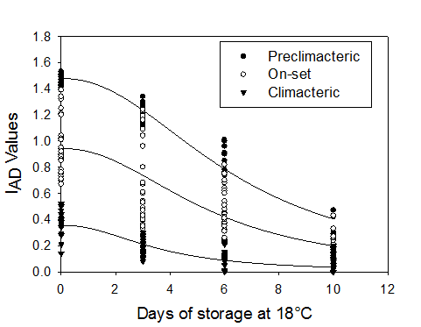
Summer Flare 34 at 18 °C

Slide 35
Regression parameters
‘September Sun’ peach - overall Adjusted R² = 0.88; P<0.0001
Temperature | 0°C |  |  |  | 7 °C
Parameter | b | a | X₀ | Adj R² | b | a | X₀ | Adj R²
Preclimacteric | 2.055 | 1.404 | 56.167 | 0.26 | 2.055 | 1.408 | 8.263 | 0.90
On-set | 2.055 | 0.734 | 52.458 | 0.27 | 2.055 | 0.753 | 7.645 | 0.83
Climacteric | 2.055 | 0.322 | 51.780 | 0.14 | 2.055 | 0.342 | 9.424 | 0.60
‘Summer Bright’ nectarine - overall Adjusted R² = 0.87; P<0.0001
Temperature | 0°C |  |  |  | 7 °C
Parameter | b | a | X₀ | Adj R² | b | a | X₀ | Adj R²
Preclimacteric | 1.567 | 0.639 | 41.163 | 0.48 | 1.567 | 0.671 | 4.207 | 0.95
On-set | 1.567 | 0.399 | 24.818 | 0.52 | 1.567 | 0.405 | 6.689 | 0.81
Climacteric | 1.567 | 0.137 | 20.640 | 0.56 | 1.567 | 0.122 | 5.495 | 0.77
‘Summer Flare 34’ nectarine - overall Adjusted R² = 0.84; P<0.0001
Temperature |  |  |  |  | 18°C
Parameter |  |  |  |  | b | a | X₀ | Adj R²
Preclimacteric |  |  |  |  | 2.158 | 1.478 | 6.359 | 0.94
On-set |  |  |  |  | 2.158 | 0.943 | 5.412 | 0.62
Climacteric |  |  |  |  | 2.158 | 0.356 | 3.577 | 0.60

Slide 36
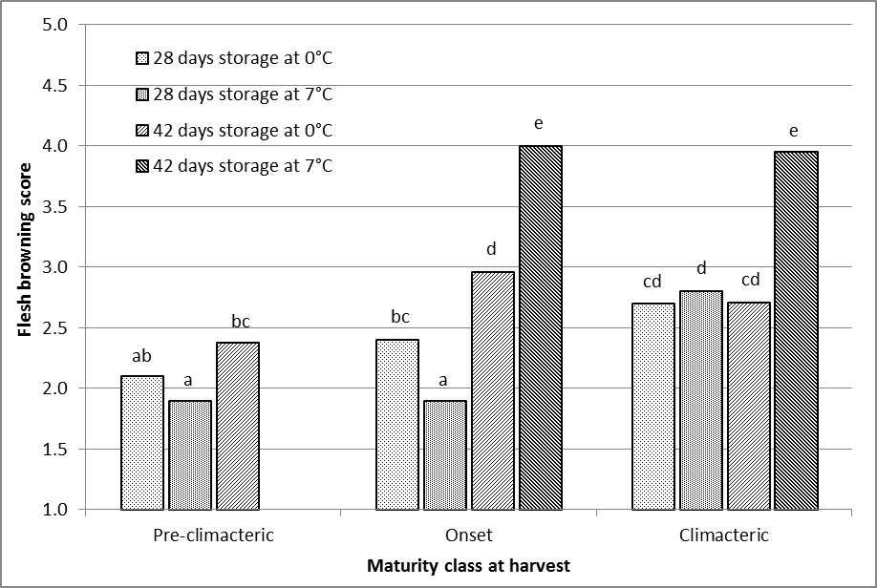
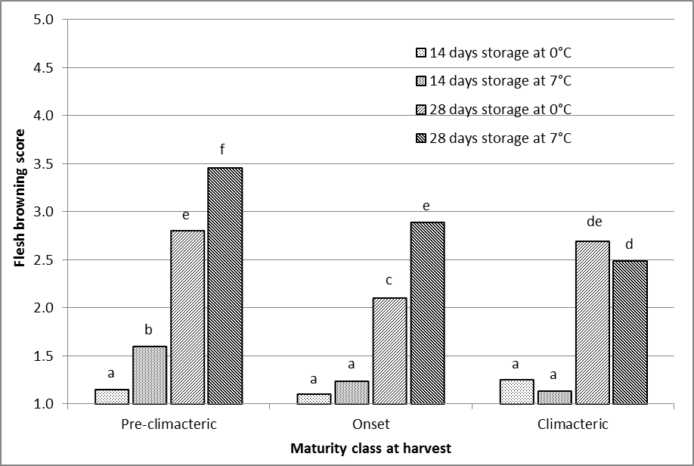
Disorders – Flesh Browning
September Red nectarine
Fig. 1. Effect of physiological maturity, and storage temperature and duration, on flesh browning severity score (n=20 fruit per maturity, storage temperature and duration combination).
Means followed by different letters are significantly different at P<0.05.
*Pre-climacteric September Red fruit at 42 days and 7°C was not assessed
*
September Sun peach

Slide 37
Eating Quality Williams 2014
Sugar to acid ratio (ºBrix/TA)
Notes:
Test is be made for stone fruits by Carlos Crisostio, we try to transfer it to pears.

Slide 38
Postharvest effectiveness
For stone fruit I_{AD} in postharvest decays following a sigmoidal logistic regression
Cultivar, Temperature and Maturity class affect regression parameters
Disorders and potential consumer acceptance are identifiable by maturity
More work needed to become a fully predicting model.

Slide 39
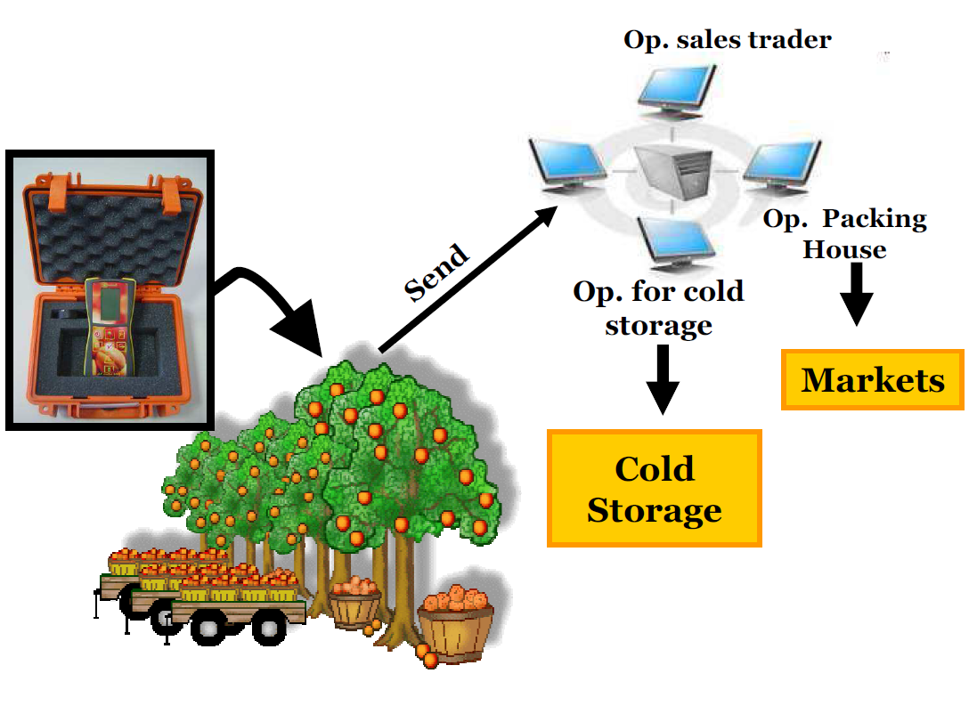
Fruit maturity (I_{AD}) as common denominator to monitor quality and determine next step in the chain (market of choice)
Happy Consumer

Slide 40
Usefulness along the supply chain
Pre-Harvest
  Understand the orchard
  Optimise agronomic practices
  Reduce number of picks
  Reduce fruit variability
  Identify harvest windows (prediction tool)
  Harvest at the correct time for the chosen market
Notes:
Summary

Slide 41
Usefulness along the supply chain
Post-Harvest
  Monitor maturity of stored fruit
  Determine shelf-life potential
  Determine length of storage depending on the chosen market
  Sort fruit according to maturity (suitability of postharvest treatments – 1-MCP, maturity retardants)
  Increased market flexibility
  Reduced variability and therefore losses
  Increased consumer satisfaction
Notes:
Summary

Slide 42
Current field projects
Aim: Increase sugar content and reduce intra canopy SSC, maturity, and size variability
Through: rootstock evaluation, tree training, irrigation timing
Interaction with crop load

Slide 43
Current post harvest projects
Determination of protocols to predict storage length depending on temperature and maturity (value chain simulation)
Interaction with ripening inhibitors (CA, 1-MCP)

Slide 44
Current post harvest projects
Correlation of I_{AD} values with aroma development pre and post harvest
Correlation of I_{AD} values with fruit ripening enzymes in pre and post harvest
Consumer responses to fruit quality affected by storage length and maturity

Slide 45
Needed research
Variety calibration for the DA-Meter
Verification and protocol creation for different species (pre and post harvest)
Correlation of I_{AD} values with other physiological or molecular parameters
Consumer responses to fruit quality affected by storage length and maturity
Value Chain fully predicting model

Slide 46
DA Technology - Conclusion
Allows rapid and accurate measurement of fruit maturity along the whole chain providing consistent quality fruit that meets consumer expectations
Allows to build a brand of guaranteed quality

Slide 47
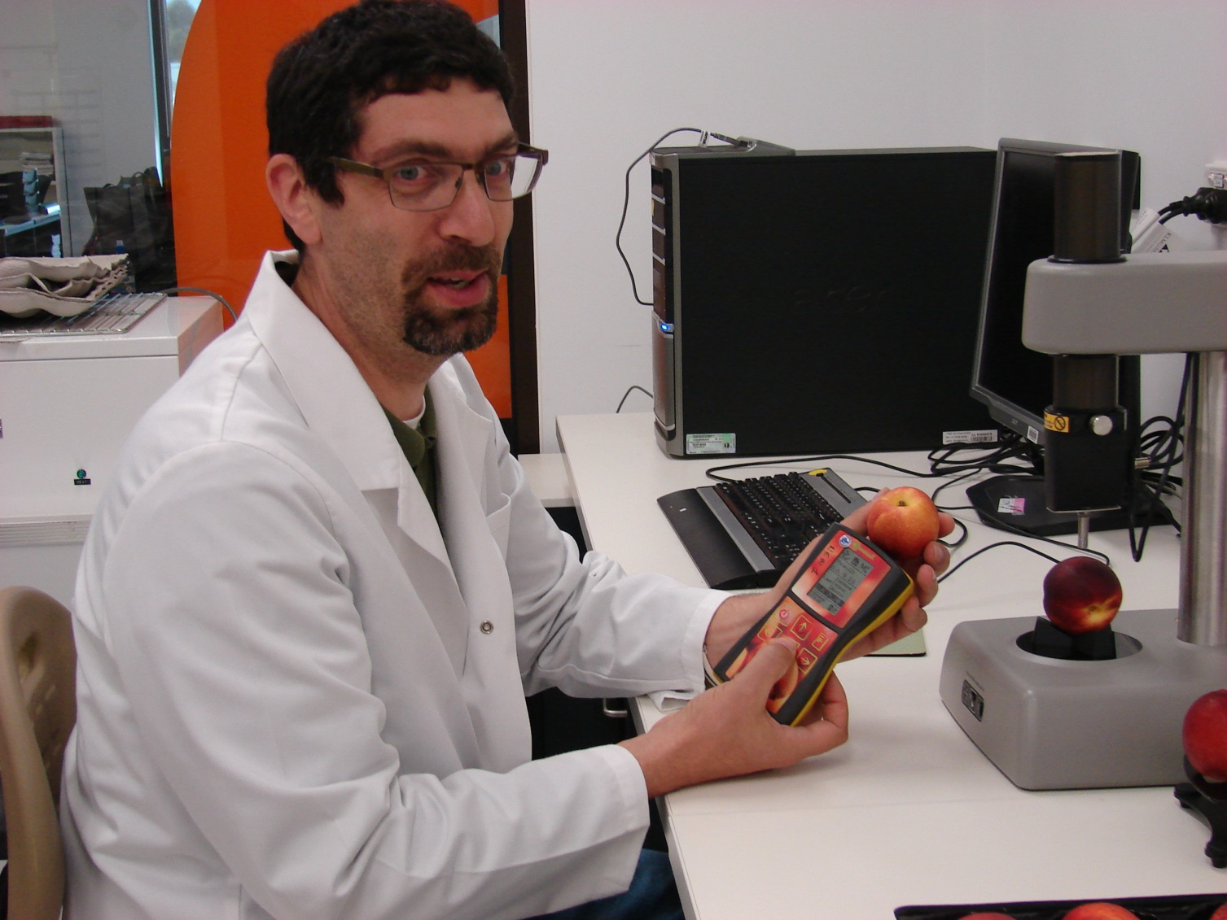


Thanks to:
Growers
Colleagues
International
Students
Funding:
Sooo! Questions?

