Slide 1
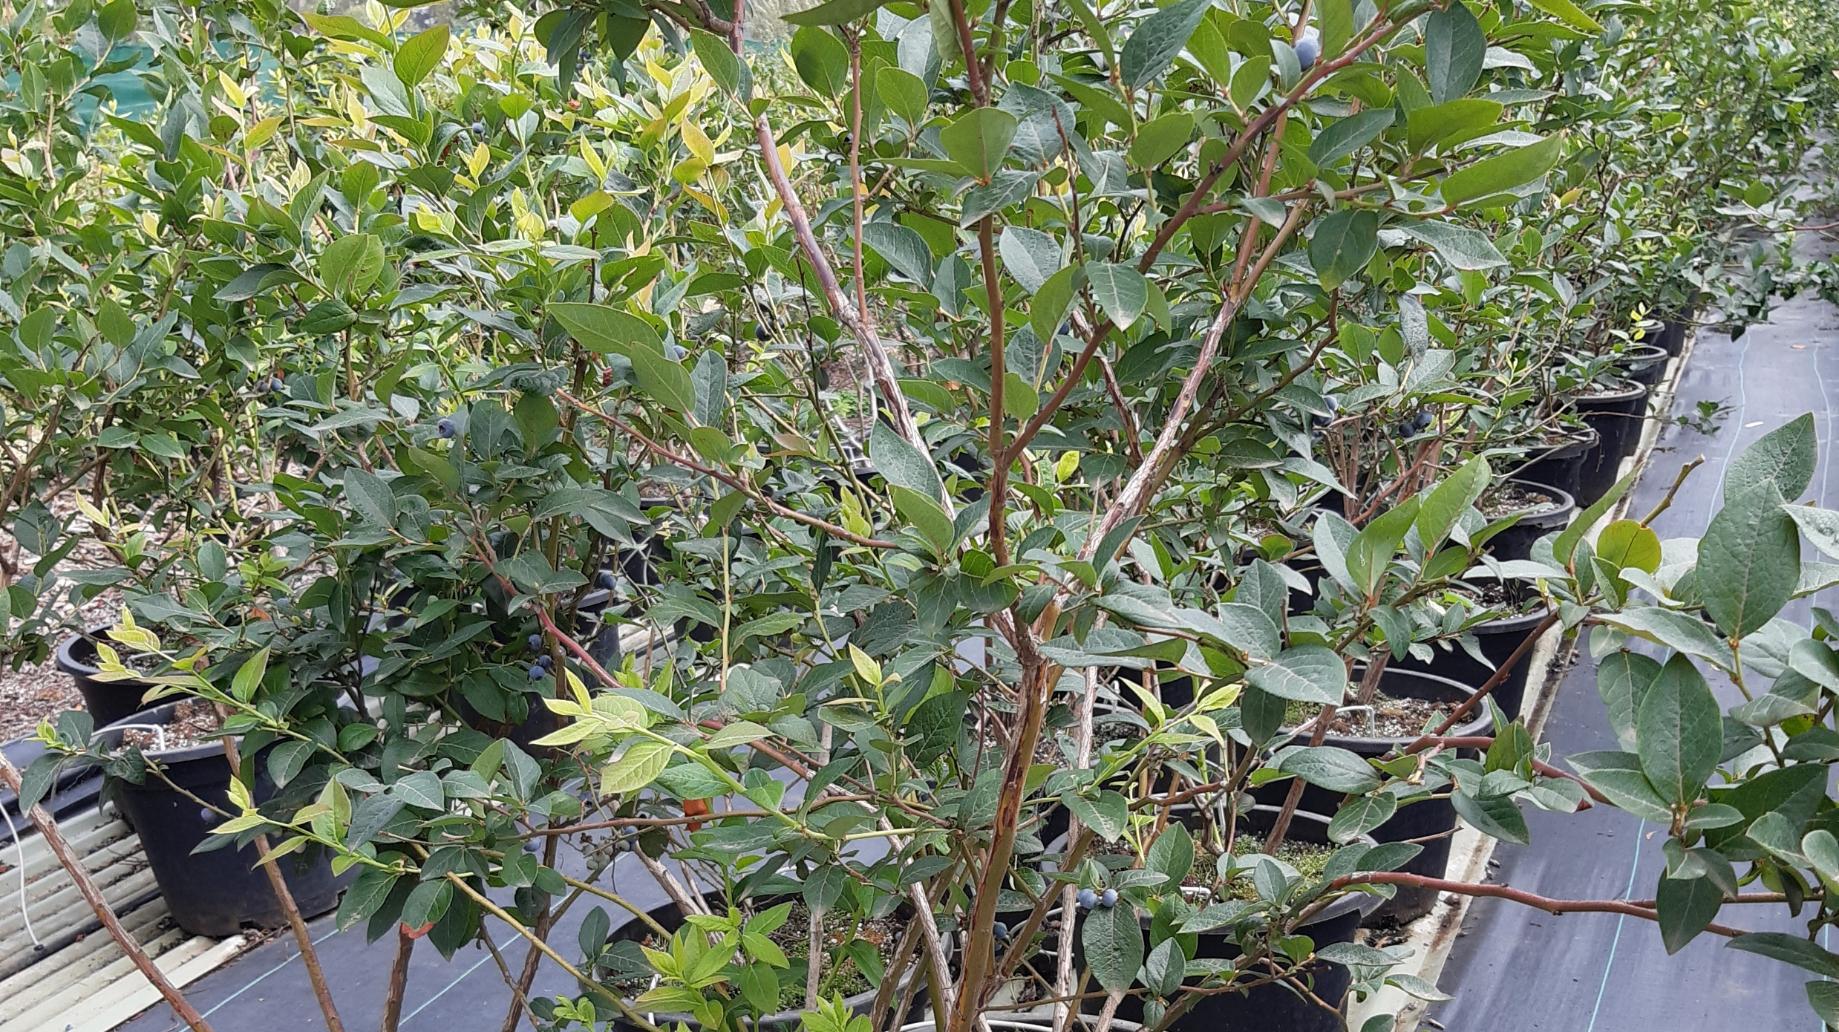

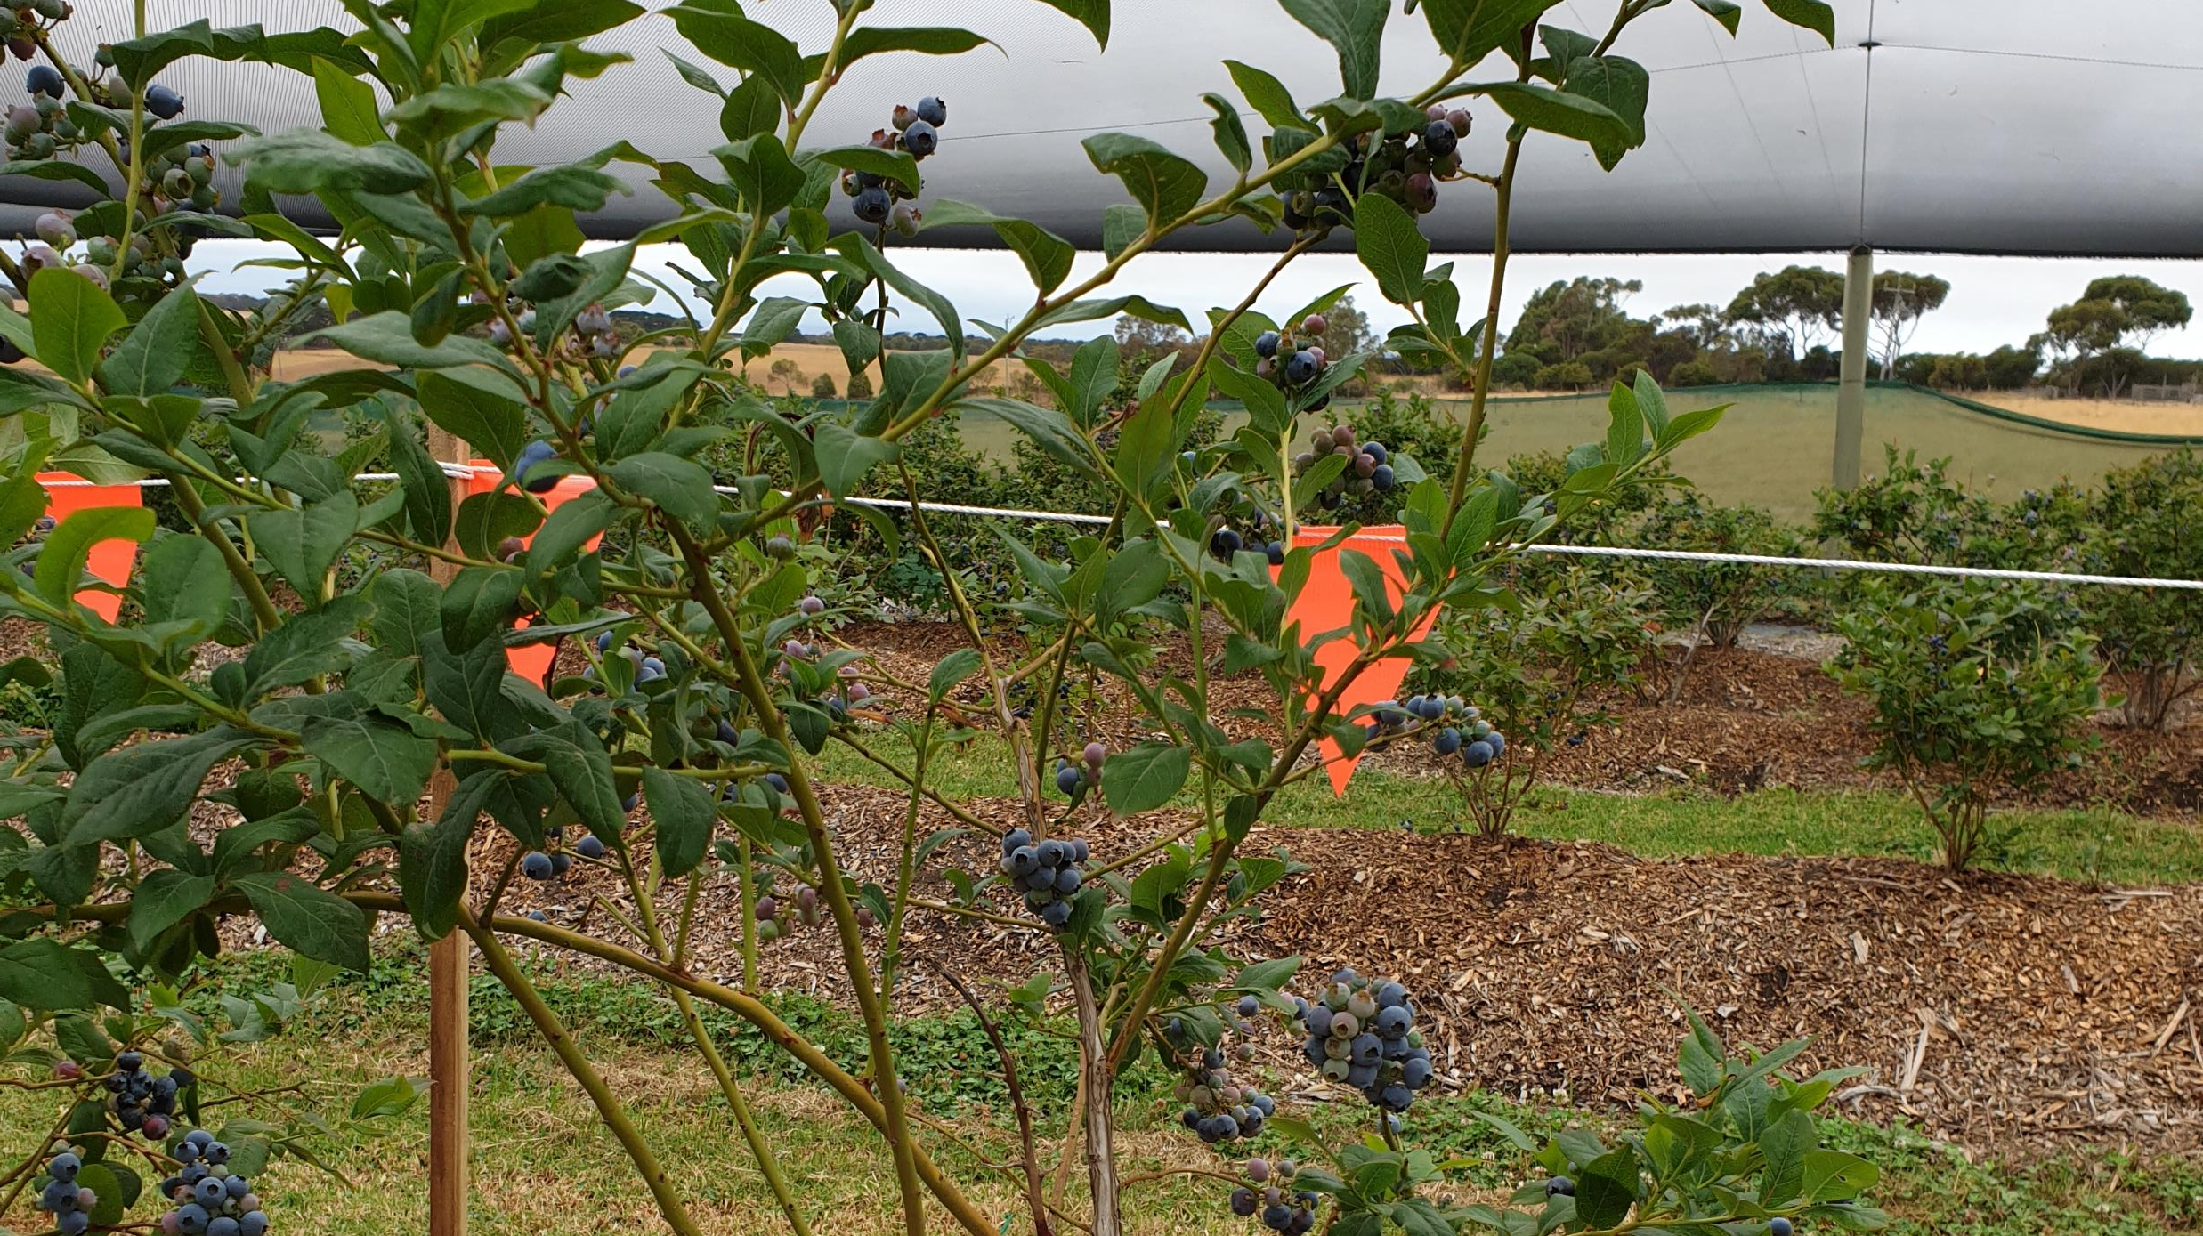
Comparing hydroponic to soil grown blueberries
4-year-old Blue Crop blueberry bushes, grown in substrate or soil, inside bird/hail netting within 100 metres of each other in Victoria Australia.
  How do they compare based on fruit yield (number and weight) and fruit taste (sweetness and mouth feel)?
  What impact does an increase of the nutrient input by 10% have on these measurements in hydroponically the grown plants?

Slide 2
Research Questions
RQ1: How do the economics of hydroponics compare with the economics of standard blueberry practices?
RQ2: What is the impact on fruit production quantity and quality of increased nutrient solutions for hydroponic blueberry productions?

Slide 3
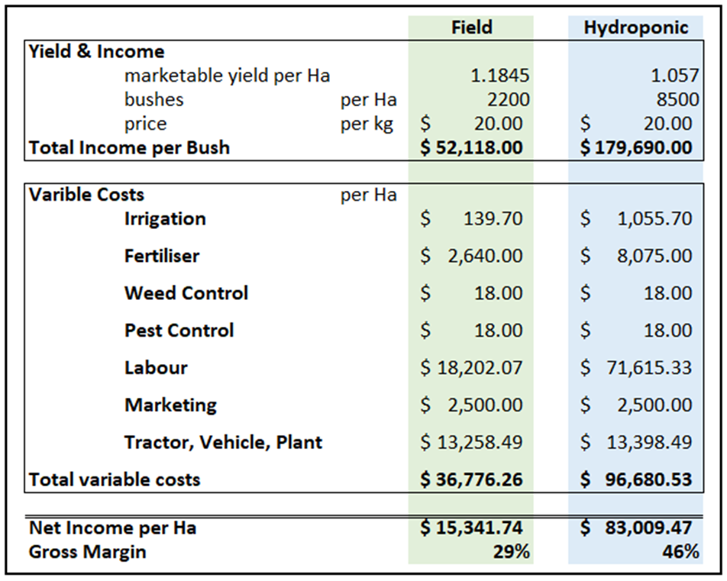
Research Question 1:
How do the economics of hydroponics compare with the economics of standard blueberry practices?
Table 2 shows the summary Gross Margin analysis per hectare, comparing Field Grown to Hydroponic Blueberry production at Tuckerberry Hill Farms for semi mature (4 year old) bushes, for the 2019/20 year (Forbes, p.2).
“Replacement of poor performing Blueberry rows with Hydroponics makes economic sense for the Tuckerberry Hill Farm based on trials run over the 2019/20 year. With little to no yield penalty per bush, but the ability to have a higher plant density the extra labour cost per hectare is compensated with economies of scale” (Forbes, p.5).

Slide 4
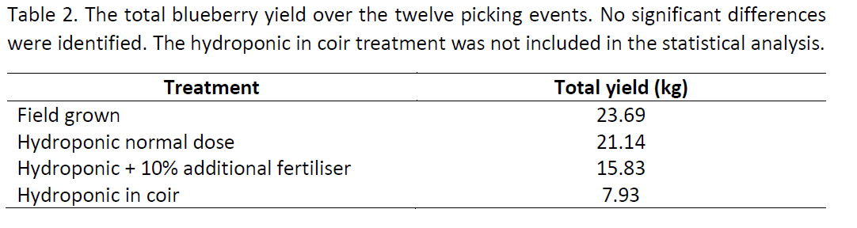
Research Question 1
How do the economics of hydroponics compare with the economics of standard blueberry practices?
Yield Comparison:
Total kgs harvested from 12 pickings over 39 days
Each treatment was administered to 20 Blue Crop bushes
Ref: Little, K & Patti, T. (2020, p.7).

Slide 5
Research Question 1
How do the economics of hydroponics compare with the economics of standard blueberry practices?
“There was no significant difference over all twelve picking events in the total yield of blueberries from field grown conditions compared to that in hydroponics” (Little & Pattie, p.5).
“Given the early peak in blueberry yield from hydroponic conditions followed by the later peak from plants grown in field, having both growing conditions at Tuckerberry Hill has the potential to extend the time frame of higher fruit yields over the season” (Little & Pattie, p.5).

Slide 6
Research Question 2
What is the impact on fruit production quantity and quality of increased nutrient solutions for hydroponic blueberry productions?
“there was a trend of higher Brix from the fruit picked from hydroponic conditions with a normal dose of fertiliser” (Little & Pattie, p.14).
“An additional 10% nutrient loading in the hydroponics treatment did not result in a higher yield or an increase in berry numbers, thereby not justifying the increased cost” (Little & Pattie, p.15).

Slide 7

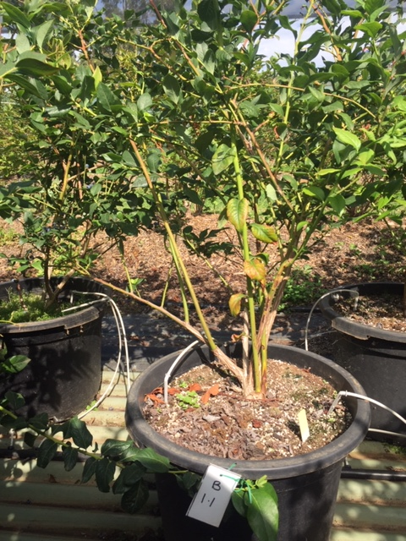
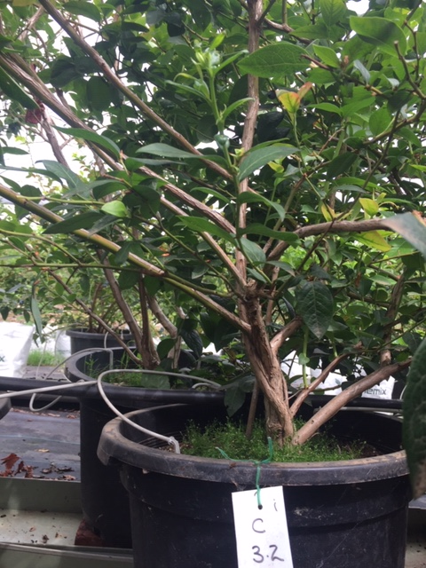
Research Question 2
What is the impact on fruit production quantity and quality of increased nutrient solutions for hydroponic blueberry productions?
At the end of the 2020 harvest, comparing the bush vigor and growth of normal nutrient solution bushes with the 10% increase nutrient solution bushes.
10% increase nutrient bushes exhibited:
Thicker stems
More new branches over the season
More shoots from the base over the season
Normal Solutions bushes exhibited:
Less dense vegetation at the base of the plant
Longer thinner stems
The 10% increase nutrient bushes did not produce more during this trial however will they produce more next year?

Slide 8
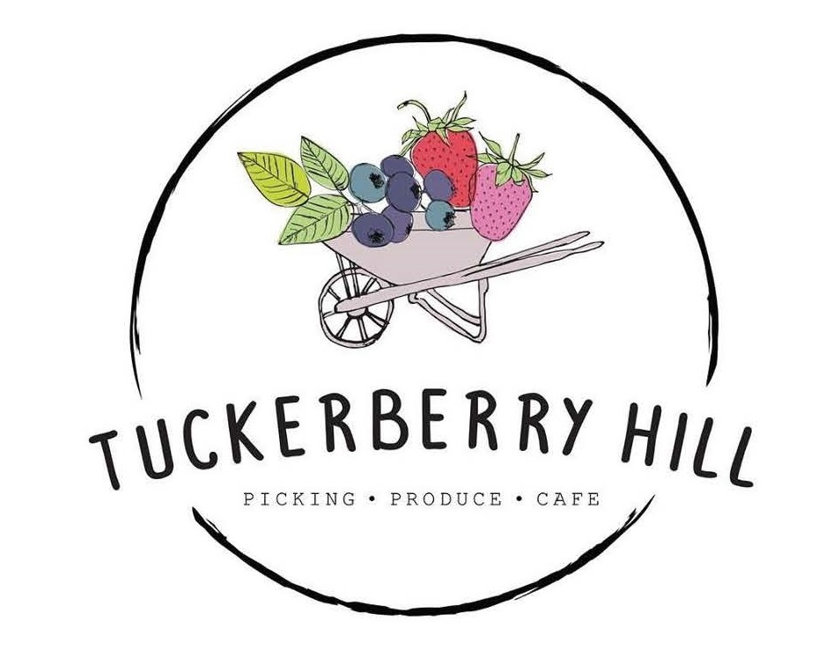



Acknowledgements
Forbes & Associates
Agriculture Consulting

